Slide 1
Set Up for Success
Presented by Anna Foote, NEKLS, February 7, 2017

Slide 2
Three Components
Set expectations that the adults in the room are the co-teachers of their children.
Create a program structure that facilitates active participation.
Redirect disruptive behaviors that happen during programs.

Slide 3
discuss
Which is the most challenging component for you?
Which do you handle best?

Slide 4
expectations
Set expectations that adults are the co-teachers of their children.

Slide 5
“The presenter is less of (an) entertainer and more of a facilitator or catalyst who encourages interaction between adults and children.”
- Sue McCleaf Nespeca

Slide 6
“The parent is the key component in storytime…I agree that (programming) should be fun and entertaining. But the parents need to be in the room. And we need to be modeling to them.”
- Sue McCleaf Nespeca

Slide 7
“Storytime is not a performance;
it’s an interactive experience between you
and the people in front of you on any particular day.”
- Nell Colburn

Slide 8
“Establish clear expectations
for both adult and child storytime behavior.”
- Nell Colburn

Slide 9
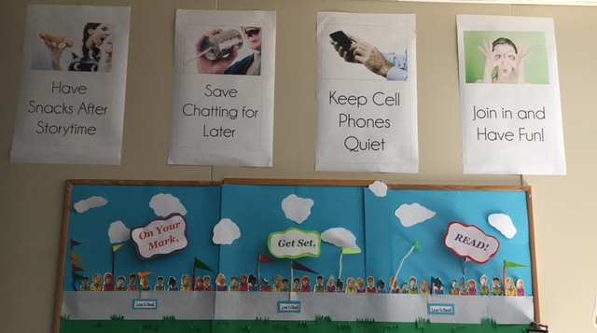

Slide 10
Storytime Guidelines
When you attend a library program,
we want to provide an inviting experience for you and your family. Please keep these guidelines in mind to help us assure that everyone has fun!
Notes:
1. Adult participation is important. Whether or not you are seated next to your child, please join the in the activities and show your child that it’s fun. You are the best person to help your child focus and learn.
2. Please refrain from conversations during the program. You are welcome to stay afterward and talk with others in attendance.
3. Please turn off all cell phones and other electronics before we start, and put away reading materials.
4. If your child cries loudly, loses control or otherwise distracts the group, please take him or her out of the room to regroup. Not every child is going to be in the mood for a story, and we understand that. If you are unable to calm your child today, please do try storytime again another day.

Slide 11
discuss
What can you do to set expectations for your Early Literacy programs—for children and for adults?

Slide 12
structure
Create a program structure that facilitates active participation—for children and for adults.

Slide 13
“Invite caregivers in with clear language and reasons.”
- Dana from Jbrary

Slide 14
“Adults appreciate knowing that storytime materials and techniques are supported by research and boost early literacy skills. For many, this gives storytime more legitimacy and educational value.”
- Nell Colburn

Slide 15
giving adults active roles
“Build in time to connect” – before and after program
Provide nametags for children and adults
Highlight guidelines / point out sign
Have children introduce themselves (or have adults intro children)
Props, like puppets or flannelboards
Distribute instruments/manipulatives to adults as well as children

Slide 16
giving adults active roles
Use songs and rhymes that encourage/require adult participation
Use books that encourage interaction
Give Early Literacy asides
Post flipcharts/posters or project images of rhymes and songs
Distribute take home handouts

Slide 17
discuss
What are some ways that you want structure (or restructure) your Early Literacy programs?

Slide 18
Redirect
Redirect disruptive behaviors that happen during programs.

Slide 19
discuss
What are some redirection strategies you want to try?

Slide 20
Use your favorite book to think of:
a way to make it more interactive during reading time
an extension activity you might use
an Early Literacy aside you might say about the book
an activity and tip you might put on a take home handout

Slide 21
“We are intentional about the ways that we support early literacy in storytimes. This intentionality includes articulating to adults the connection between what we do in storytimes and later reading. We articulate ways…caregivers can continue supporting early literacy even after storytime is over.”
- Ghoting and Martin-Diaz, Storytimes for Everyone!

