Slide 1

Break
ut
Youth Program
Presented by Kelley Nordberg and Emily Gansel
Wamego Public Library

Slide 2
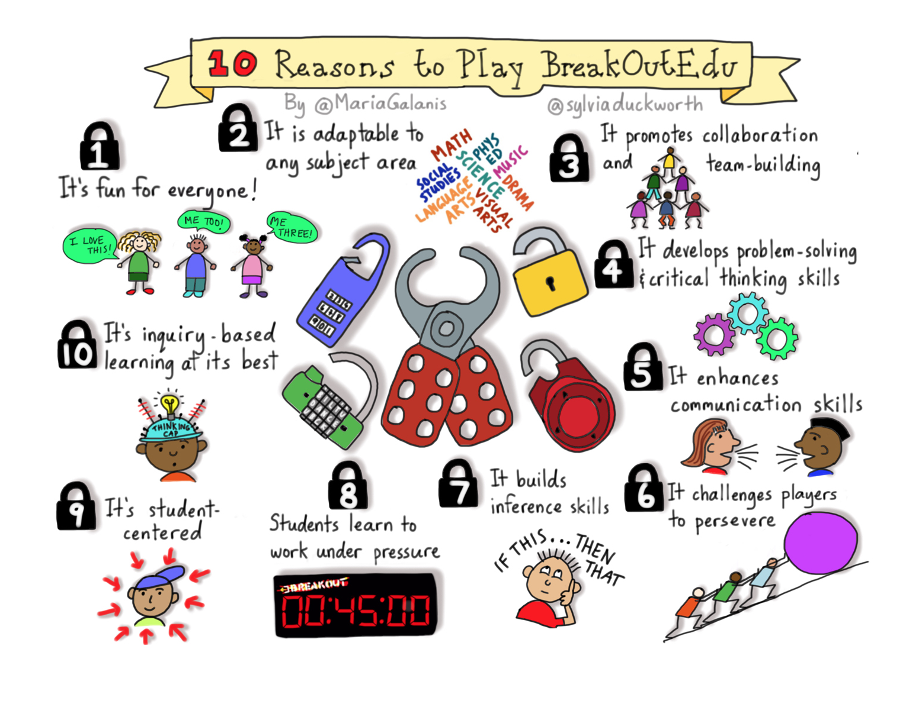

Slide 3
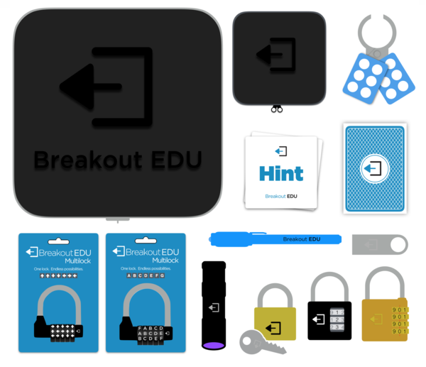
What comes in the Breakout Edu Kit?
What did we add?
more boxes
more locks
props
tech device

Slide 4
Tips for success
keep your groups limited to 5 or 6 kids
stress teamwork and collaboration
don’t underestimate kids ability, make it a challenge
utilize teen volunteers
adapt the program to all ages
all the reward necessary is a paper certificate, completing the puzzle is the real reward
lock care tips for storing and resetting
http://www.breakoutedu.com/locktips

Slide 5
directions
6 different boxes, 6 different puzzles
figure out the puzzle, unlock the box, take a puzzle piece
when all boxes are unlocked you will be able to complete your puzzle
make sure you:
work together! everyone on your team needs to try a combination before YOU try it again
share the info with your team – but not anyone else!
don’t just try to guess combinations – the goal is to figure out the puzzles!
if you’re sure you have the right combination but it isn’t working, reset the lock!

Slide 6
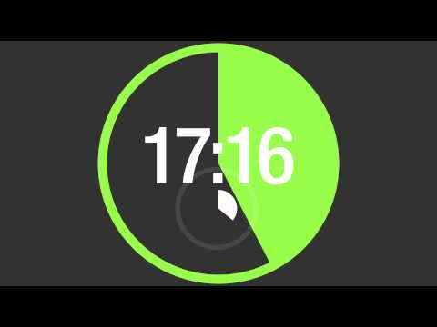
Timer

Slide 7
file:///C:/Users/Librarian/Desktop/201702271446_0001.pdf
Brainstorm Worksheet

Slide 8
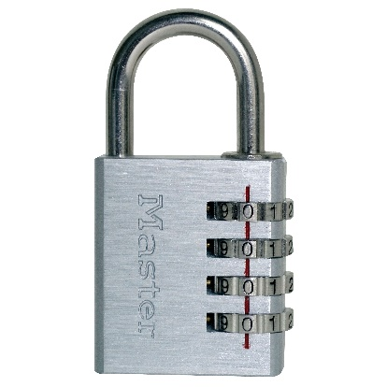
4 digit lock
Lock Combination : 4050
Littles
received the article + a question
Middles
received a longer article + question (longer articles have more “distractors”)
Bigs
received the article only

Slide 9
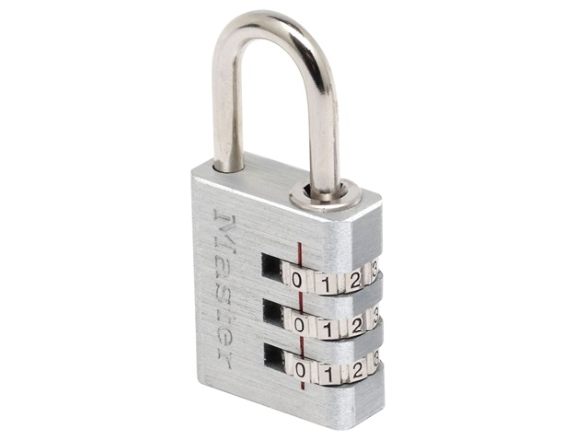
3 digit lock
Lock Combination: 541
Littles
QR Code -> picture with the answer in a sentence
Middles
QR Code -> picture with the question (must go on the web to find answer)
Bigs
QR Code -> question only (no picture clue)

Slide 10
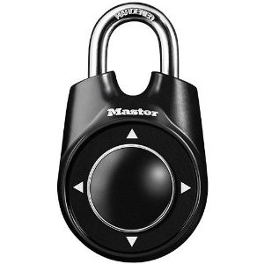
Directional Lock
Lock Combination: Right, Down, Right, Up, Right, Right, Right, Down
Littles
follow construction signs
Middles
map
Bigs
envelope with addresses

Slide 11
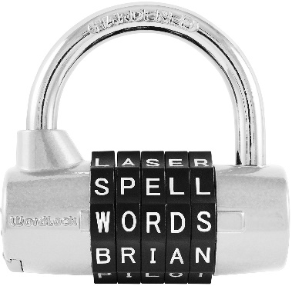
Word Lock
Lock Combination: WORLD
Littles
page # and a clue for the word itself
Middles
page # and clues for each letter – word in order
Bigs
page # and clues for each letter – word scrambled

Slide 12

Key Lock
Lock Combination: Must bring librarian tools as requested to receive key
Littles
two pictures of specific tools
Middles
three words (must find tools to match)
Bigs
three definitions (must find tools to match)

Slide 13
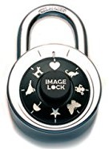
image Lock
Lock Combination: bird, dog, cat
Littles
solve Rebus puzzles, given order of clues
Middles
solve Rebus puzzles, determine order of clues
Bigs
solve Rebus puzzles, determine order of clues

Slide 14

Questions?

Slide 15
Resources
Breakout EDU
Breakout Edu http://www.breakoutedu.com/
Teachers Pay Teachers
https://www.teacherspayteachers.com/Browse/Search:breakout%20edu
Pinterest
Brainstorm Worksheet
https://docs.google.com/document/d/1i-qu9bsOTopvHxKZCddl0Kc_jC7t-ITJ57mLfWX2_Kw/mobilebasic
QR Code Website
https://www.qrcode-monkey.com
Emily Gansel
childrens@wamegopubliclibrary.com
Kelley Nordberg
info@wamegopubliclibrary.com

