Slide 1
HUMAN RESOURCES
Is there a hat for that?

Slide 2

PAIN-FREE HIRING

Slide 3
ARE THEY EMPLOYEES OR CONTRACTORS?
IRS “COMMON LAW RULES”
BEHAVIORAL
Control of Work and Worker
FINANCIAL
How paid? Tools and Supplies?
TYPE OF RELATIONSHIP
Written Contract or Employment
https://www.irs.gov/Businesses/Small-Businesses-&-Self-Employed/Independent-Contractor-Self-Employed-or-Employee
Exempt or Not? Who Gets Overtime and When? https://youtu.be/aKauaHCNS3A

Slide 4
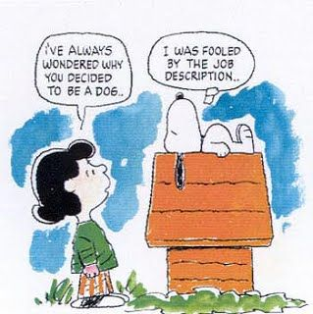

Slide 5
JOB DESCRIPTION
TITLE
FLSA STATUS
POSITION SUMMARY
QUALIFICATIONS
ESSENTIAL FUNCTIONS
MARGINAL FUNCTIONS
POSITION REQUIREMENTS
EDUCATION
TECHNICAL SKILLS
DECISION MAKING
PERSONAL RELATIONS
ESSENTIAL PHYSICAL FUNCTIONS
SELECTION GUIDELINES
EMPLOYEE CERTIFICATION

Slide 6
JOB INTERVIEW
ESTABLISH STRUCTURE WITH CANDIDATES
STICK TO SAME STRUCTURE AND SET QUESTIONS FOR ALL CANDIDATES
CAN ASK SPECIFIC QUESTIONS AS FOLLOW-UP OR SPECIFIC TO RESUME/APPLICATION
ALWAYS FOLLOW A YES/NO ANSWER WITH AN OPEN-ENDED QUESTION
PROVIDE INFORMATION ABOUT YOUR LIBRARY
CLOSE THE INTERVIEW – TIMEFRAME
EVALUATE NOTES AND COMPARE CANDIDATES
DO NOT MAKE ANY NOTES THAT COULD BE DISCRIMINATORY

Slide 7
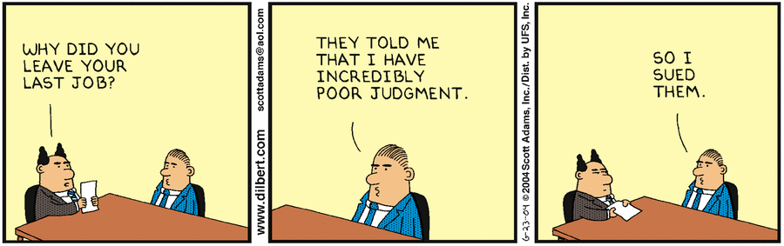

Slide 8
VOLUNTEERS
HAVE A PLAN
NEEDS ASSESSMENT
FRIENDS GROUP/VOLUNTEER RELATIONSHIP
WORKING WITH STAFF
CHECK INSURANCE
DEVELOP VOLUNTEER GUIDELINES/HANDBOOK
THINK THROUGH OUTCOMES
DECIDE ABOUT BACKGROUND CHECKS
JOB DESCRIPTION
BASIS FOR RECRUITING, INTERVIEWING AND SELECTION
JOB APPLICATION
HIRING AGREEMENT
“HOLD HARMLESS STATEMENT”

Slide 9
THE SWEET MIDDLE
Paperwork, Paperwork, Paperwork
http://systems.mykansaslibrary.org/wp-content/uploads/RecordRetention-Schedule-2008.pdf

Slide 10
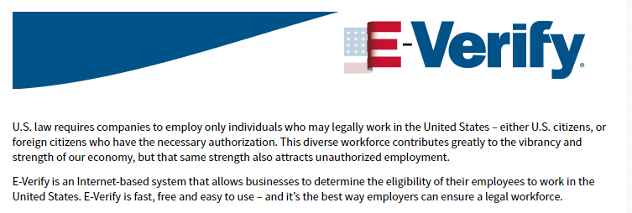
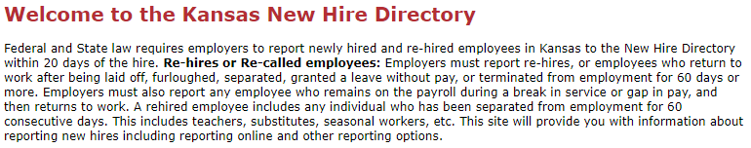
https://www.uscis.gov/e-verify
http://www.dol.ks.gov/UI/newhires_BUS.aspx

Slide 11
BASIC PAYROLL DOCUMENTATION
W4
https://www.irs.gov/forms-pubs/about-form-w4
https://www.irs.gov/individuals/irs-withholding-calculator
https://www.irs.gov/newsroom/withholding-calculator-frequently-asked-questions
https://www.youtube.com/watch?v=ZK9pQXD7hKE
KW4
https://www.ksrevenue.org/pdf/k-4.pdf
I-9
https://www.uscis.gov/i-9

Slide 12
Purposes of the ADA, the FMLA and Workers’ Compensation Laws
The ADA prohibits discrimination against applicants and employees who are “qualified individuals with a disability.”
The FMLA sets minimum leave standards for employees for the birth and care of a newborn child, placement of a child for adoption or foster care, care for an immediate family member with a serious health condition, and an employee’s serious health condition.
Workers’ compensation laws provide for payment of compensation and rehabilitation for workplace injuries, and minimize employer liability.

Slide 13
Enforcement Authorities for the ADA, the FMLA and Workers’ Compensation Laws
ADA: U.S. Equal Employment Opportunity Commission (EEOC)
FMLA: U.S. Department of Labor (Wage and Hour Division)
Workers’ compensation laws: state workers’ compensation commissions

Slide 14
LENGTH OF LEAVE
ADA: No specific limit for the amount of leave that would be provided as a reasonable accommodation that does not create an undue hardship on the employer.
FMLA: 12 weeks in the 12-month period as defined by the employer.
Workers’ compensation: No specific limit for the amount of leave an injured worker may have.

Slide 15
MOVING AHEAD
SHARE THE LIBRARY MISSION
CLEARLY STATE EXPECTATIONS
PROVIDE THE NECESSARY TOOLS AND RESOURCES
PROVIDE OPPORTUNITIES FOR INPUT ON ISSUES
GIVE PUBLIC RECOGNITION
ALWAYS GIVE PRIVATE FEEDBACK ON JOB PERFORMANCE

Slide 16
Types of Documentation
Handwritten or typed notes from coaching and counseling sessions with employees.
Follow-up email summarizing a performance discussion meeting.
Written comments including specific examples in performance reviews.
Disciplinary actions, such as warning documents with specific examples and consequences.
Handwritten or typed explanations with reasons for employment actions such as demotions, promotions and layoffs.

Slide 17
Reasons Documentation Is Important
Establishes a record of employment actions taken and the reasons for the actions. Memories fail, managers move on and other circumstances change.
Informs employees of what is expected of them and the consequences if they do not meet expectations. Employees should never be surprised when they are in a termination meeting.
From a performance management standpoint, it serves as a written record to guide both the employer’s and the employee’s future behavior. It gives the employee the opportunity to improve.
Serves as evidence of the employer’s business reasons for actions taken, in the event an employee takes formal or informal steps with a claim against a manager or employer.
Brings about fair and equitable treatment. No one wants to be blindsided or treated differently than other employees.

Slide 18
Effective Documentation
Effective documentation will generally include:
The employer’s expectation.
How the employee or volunteer has failed to meet that expectation.
Prior counseling or discipline.
The employer’s expectations for the employee or volunteer going forward.
The consequences of the employee’s or volunteer’s failure to make the requisite improvement.

Slide 19
Summary
Documentation is important for both the employer and the employee.
Good documentation answers the questions who, what, where, and when.
Document early. Do not wait.
Discussion without documentation equals misunderstandings.
Discuss and document only the facts.
Ask the employee to sign documentation of disciplinary actions.
Give specific examples for how the employee is not meeting expectations and specific guidance for how the employee can improve. Ask the employee to sign documentation of disciplinary actions.
Give a copy of the disciplinary action to the employee.

Slide 20
Employment Actions that Require Documentation
Setting and revising annual performance goals and objectives.
Midyear and annual performance reviews.
Violation of company policy, procedure, practice or code of conduct.
Attendance issues.
Poor performance.
Safety violations.
Investigations.
Demotions.
Promotions.
Change in job duties.
Training needs and accomplishments.
Bonus and merit increase decisions.
Placing an employee on probation.
Suspension.
Termination.

Slide 21
YOUR EMPLOYEE HANDBOOK: THE MOST IMPORTANT BOOK IN YOUR COLLECTION
Notes:
Needs to be a living document – just like a good strategic plan. This is NOT something you write ONE time and put on the shelf!

Slide 22

The Good, The Bad and The Must Haves

Slide 23
IT STARTS WITH THE LIBRARY BOARD
PERSONNEL POLICY/EMPLOYEE HANDBOOK
PROVIDES STRUCTURE
HELPS ESTABLISH THE LIBRARY’S CULTURE
PROVIDE GUIDANCE FOR HANDLING SITUATIONS
HAVE ACKNOWLEDGEMENT SHEET FOR EMPLOYEE FILE
NEEDS REVIEWED REGULARLY
http://policies.mykansaslibrary.org/
Notes:
These policies define the treatment, rights, obligation and relations of the people in an organization. The blueprints or the organization
Structure – Communication tool Disclaimers about possibility of change allows right to change without notice
Culture – sets employment expectations and consequences
Workplace inspections – drug testing & background check – helps reduce expectation of privacy

Slide 24
PERSONNEL POLICY CHECKLIST
You know that personnel policies define the treatment, rights, obligations, and relations of people in an organization.
Your personnel policies include instructions and rules for dealing with issues and overcoming obstacles to a successful work environment.
You will write personnel policies in clear, understandable language.
Your personnel policies are consistent with the beliefs and mission of the organization.
Your general policies deal with the basic structure, philosophies, and rules of the organization.
Your organization includes all elements of the worker's employment relationship in hiring and employment status policies.
You understand that everyday procedural policies include all the issues that surround daily operation for employees and volunteers.
http://ctb.ku.edu/en/table-of-contents/structure/hiring-and-training/personnel-policies/checklist Community Tool Box
Notes:
Organizations often generate handbooks which include personnel policies that employees are given when they join.
These handbooks usually outline the history and mission of the organization, the actual policies and the reasoning behind them, and how the policies will be administered. Supplemental policies may develop as the need arises. For example, many companies have recently added policies regarding Internet usage, electronic devices

Slide 25
TYPES OF PERSONNEL POLICIES
General Policies
Hiring
Employment
Everyday Procedural
Be Clear, Be Current, and Be Comprehensive
Notes:
Hiring can be a policy outside of the employee handbook

Slide 26
KEY COMPONENTS
INTRODUCTION
FOR ALL EMPLOYEES
BY GOVERNING BODY
STATEMENT OF AUTHORITY
ONLY LIBRARY BOARD CAN CHANGE
NOTICE OF CHANGE NOT REQUIRED
EMPLOYMENT RELATIONSHIP
AT-WILL, NOT A CONTRACT
Notes:
For all employees – employee responsible for reading and becoming familiar
Handbook NOT a contract – express or implied
Right to change without notice – current handbook supersedes all previous policies and memos

Slide 27
GENERAL POLICIES
EQUAL EMPLOYMENT OPPORTUNITY POLICY
CITIZENSHIP
NEPOTISM (WITH DEFINITION OF IMMEDIATE FAMILY)
AMERICANS WITH DISABILITY ACT (ADA)
REASONABLE ACCOMODATION
FAMILY MEDICAL LEAVE (FMLA)
NON-HARASSMENT POLICY
INJURY
TOBACCO, ALCOHOL AND DRUGS
WEAPONS
ELECTRONIC EQUIPMENT USE
INCLEMENT WEATHER
Notes:
EEO – non-discrimination statement – race, color, religion, sex, age, national origin, disability or any other basis prohibited by law
US citizen or valid permits
Immediate family – spouse, children, grandchildren, grandparents, parents and comparable step-family and in-laws
ADA/FMLA – Can request accommodation for health issue under ADA even before qualified for FMLA
Weapons – guns, knives, etc. Kansas gun laws allow carry unless special security measures are installed. Some of you may be currently “no gun” under the exemption by the AG – when time is up, choose
Electronic equipment use

Slide 28
EMPLOYMENT POLICIES
STANDARDS OF CONDUCT/CONFLICTS OF INTEREST
GRIEVANCE PROCEDURE
TERMINATION
RESIGNATION OR RETIREMENT
PERSONNEL RECORDS/EVALUATIONS
STAFF DEVELOPMENT AND TRAVEL
POSITION CLASSIFICATION – GENERAL POLICY AND POSITION CATEGORIES
WORK WEEK/TIMESHEETS/PAYPERIODS
BREAKS – not required
OVERTIME/COMPENSATORY TIME OFF
DRESS CODE
Notes:
Standards – reflect mission and vision
AT-WILL DOES NOT MEAN A LACK OF DOCUMENTATION
FOLLOW THE STEPS IN YOUR POLICY
KNOW EFFECTS OF TERMINATION VERSUS RESIGNATION
TERMINATION PAPERWORK
WHEN TERMINATING, ALWAYS HAVE A WITNESS
Personnel Records – define employee and employer responsibilities
CE and Travel – defines reimbursement and coverage
Positions classification – exempt, non-exempt, full-time, part-time
Paid Breaks are not required under State or Federal Wage and Hour Law
WORK WEEK VERY IMPORTANT – DOES NOT HAVE TO BE SUNDAY – SATURDAY
OT/COMPENSATORY TIME OFF – COMPENSATORY TIME ALLOWED FOR EMLOYEES OF State or local government agencies. See Fact Sheet #7 State and Local Governments under the Fair Labor Standards Act –USDOL/Wage & Hour Division
How many have a dress code????

Slide 29
EMPLOYMENT BENEFITS - LEAVE
HOLIDAYS
VACATION/PERSONAL DAYS
SICK LEAVE
FUNERAL LEAVE
JURY DUTY
MATERNITY/PATERNITY LEAVE
MILITARY LEAVE
LEAVE WITHOUT PAY
Notes:
Holidays – how covered for part-time and full-time, list, detail when falls on the weekend
Vacation/personal days – not required under FLSA or State – must treat all the same -- when to start, how calculated (establish a minimum amount of time), time-in-service -- payout at resignation? or retirement?
Sick leave – not required under FLSA or State , how calculated(establish a minimum amount of time used), who can earn, payout at retirement. Termination – no payment, Resignation – usually no payment
Funeral leave – definition under nepotism
Maternity leave – usually without pay -- may have a Short-term disability coverage that will cover – employee choice benefit often

Slide 30
OTHER EMPLOYMENT BENEFITS
SOCIAL SECURITY
MEDICARE
KANSAS UNEMPLOYMENT INSURANCE
WORKMAN’S COMPENSATION
HEALTH/DENTAL/VSION/DISABILITY
RETIREMENT BENEFITS
KPERS
457 PLANS (EMPLOYER AND EMPLOYEE PARTICIPATION)
EMPLOYEE-PAID OPTIONAL BENEFITS
Notes:
Work Comp – not required is payroll under $20,000
KPERS – 1,000 hours or more -- has long-term disability
ST disability – can be employee or employer coverage – depends of benefits offered
Other employee paid options – OGLI if in KPERS, cancer, AD&D, etc. Think AFLAC

Slide 31
THE LAST PAGE
ACKNOWLEDGEMENT/RECEIPT
RESTATE AT-WILL EMPLOYMENT
RETAIN IN PERSONNEL FILE
VERY, VERY IMPORTANT

Slide 32
UPDATES TO POLICY?
Social Media and Data Privacy
Handbooks should make clear that there are no privacy rights to social media accessed on employer-owned equipment and utilizing social media at work.
Reasonable Accommodation
Americans with Disabilities Act (ADA) often trumps the Family and Medical Leave Act (FLMA)for medical leave.
Retaliation
Not enough to say organization will not tolerate. A statement regarding the fairness of the process for the person making the claim and for the accused is essential.
Smoking and Marijuana Use
Tobacco use should cover e-cigarettes and restrictions on where should be clearly stated
Treat medical marijuana use as a drug, and policy can clearly state that use of illegal drugs, alcohol and legal drugs which significant impairment can not be used on the job.
LGBT Rights
With the 2015 Supreme Court Decision on same-sex marriage, companies must provide the same health and retirement benefits other married couples are offered.
Notes:
Clear statements on the amount of personal use of social media at work are needed. It should also state that employer data on personal devices will be wiped clean when individuals leave employment.

Slide 33
THE BAD. . .
AT-WILL DOES NOT PROTECT FROM DISPUTES RESULTING FROM:
DISCRIMINATION
HARRASSMENT
RETALIATION
INCONSISTENT APPLICATION & DEVIATION FROM POLICY
ADOPTION OF ILLEGAL POLICIES
CONTINUATION OF OUT-DATED POLICIES
USING OTHER INDUSTRY POLICIES
OVERLY DETAILED
OVERLY VAGUE
Notes:
Not thinking through applicability – too detailed or comprehensive, from another state
A progressive discipline policy can be too restrictive.

Slide 34
REAL LIFE ISSUE
Employee is becoming first time grandmother
Has 60 hours of vacation
Wants to use sick leave
Wants additional leave (without pay) of indeterminate timeframe
The library runs with an FTE of 11 people
Open 64 hours per week
Staffing sufficient to cover regular duties and still allow for vacations and sick leave.

Slide 35
LIBRARY PERSONNEL POLICY
Employees may request to take leave without pay, depending on their personal situation. Granting the leave is at the discretion of the director, and depends entirely on the circumstances of the Library and the role the employee plays. If leave without pay is approved, it may only be used if all vacation, and sick leave if applicable, is exhausted. For positions that don't include vacation time or sick leave, an employee may take leave without pay as a way to travel or if they are unable to work. Excessive use of leave without pay is not acceptable and may lead to disciplinary action for excessive absenteeism. Failure to return to work at the end of an approved personal leave of absence will be considered a voluntary resignation.

Slide 36
ACTUAL RESPONSE & RESULT
Family Medical Leave Act (FMLA) is for taking care of a child with a “serious” health issue. So even though your child is giving birth, it is not considered a “serious” health issue unless there are complications. Therefore, employees are not able to take sick leave for the birth of a grandchild except in exceptional circumstances.
Vacation leave is approved
Leave without pay is up to the director to allow or not allow. Her response:
“The library runs with an FTE of 11people and is open 64 hours per week. We have enough staff to cover regular duties and still allow for vacations and sick leave. But we don’t have enough staff to allow for extra time off. As director, I would be reluctant to grant leave without pay unless it was absolutely necessary.”
End Result?

Slide 37
PENNY WISE, POUND FOOLISH
“DO MORE WITH LESS” STRESS
SUBPAR WORK – TOO LEAN AND TRULY MEAN
HIGHER PERSONNEL COSTS (absenteeism, workers’ compensation claims, increased healthcare expenses)
INCREASED TURNOVER DUE TO BURNOUT
MISSED DEADLINES, MISSED OPPORTUNITIES AND DISSATIFIED CUSTOMERS

Slide 38
LINKS
KANSAS DEPARTMENT OF LABOR
http://www.dol.ks.gov/Default.aspx
UNITED STATES DEPARTMENT OF LABOR
https://www.dol.gov/whd/

Slide 39
"Surround yourself with the best people you can find, delegate authority, and don't interfere as long as the policy you've decided upon is being carried out.“ — Ronald Reagan

Slide 40
“Connect the dots between individual roles and the goals of the organization. When people see that connection, they get a lot of energy out of work. They feel the importance, dignity, and meaning in their job.”
– Ken Blanchard and Scott Blanchard, Do People Really Know What You Expect from Them?, Fast Company

Slide 41
APRIL 6, 2018 Laura DeBaun, Director Northeast Kansas Library System 888-296-6963 ldebaun@nekls.org

