Slide 1

Policies For Results May-June 2018
Sponsored By:
Northeast Kansas Library System
Presented By:
Bonnie McKewon, State Library of Iowa

Slide 2
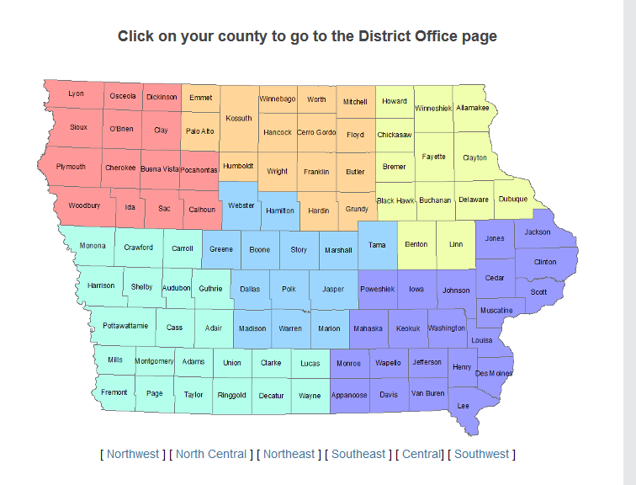
State Library of Iowa District Office Map

Slide 3


The Value of Policies
The 4 Parts to a Policy
Policy Players
Kansas Specifics
Policy Pet Peeves
Sample Blitz
Notes:
Here’s where we’re headed today…
With your help and what I’m sure will be a lively conversations from you ☺
Point to handouts NOTE-TAKING PAGE, to keep that front-and-center as a way to jot down ideas from today. Especially things you hope to try when you get back home ☺
*** *** *** ***
@ this point == ICE BREAKER by introducing people to their WORK GROUPS == in honor of St. Patrick’s Day ==
Derbies / Pot of Gold / Leprechanns / Shamrocks ☺
As noted on name badges ☺
These will be their work groups throughout the day ☺ Stay put for now, when it’s time, you’ll need to hook up with the other leprechauns later ☺

Slide 4
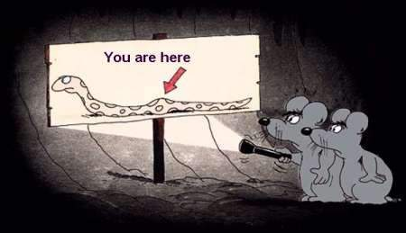

Slide 5

What are the risks associated with NOT having policies in place?
Notes:
First a question for you right up front
Allow a few minutes
AUDIENCE Q == = OPEN-ENDED POLL Q
Jean will read back answers

Slide 6


A major area of board responsibility
Many standards have policy implications
Legal & ethical issues
Demonstrates credible business practice
Opportunity for public education
Notes:
Because you’ll have these slides to look back on
Board responsibility = adopting policies is among the top 5 responsibilities as ADMINISTRATIVE BOARD
Standards = coming up next slide
Legal & Ethical = Open meetings, equal opp employment, handicap accessibility, confidentiality of library records, etc.
Credible business practice = the board and director look good, look smart, on top of the issues, you’ll be in keeping with other businesses SCHOOLS, BANKS … If GOLF COURSES have policies, surely public libraries should ☺
Opp For Public Education = An observation: you promote services, new and old. Do you also provide accompanying policies? Like in flyers or fact sheets?
People who get a library card for the first time. Do you give out a fact sheet with their library card?
Fact sheet about Internet access?
Fact sheet about eBook access and other digital products? Are your e-resources available to all library visitors or only to city residents ??

Slide 7
The Connection to Standards
Accreditation Standard 7: The library board has adopted written bylaws and policies that explicitly address the following topics. (Note: These need not be individual policies; “like” topics may be addressed together.)
Library will provide copies of all policies to NEKLS in electronic format.
Accreditation Standard 8:
Copies of bylaws and policies are provided to every member of the library board, the library director, and library staff. The library board and director reviews the bylaws and each policy at least once in a three-year cycle.
Notes:
Point to TABLE COPIES of same

Slide 8
Kansas Policy Topics
Appropriate Use of Online Services & Internet Safety
Budget and Finance
Building/Meeting Room Use
Capital Improvements
Children's Internet Protection Act (CIPA)
Confidentiality of Patron & Library Records
Continuing Education
Emergency Preparedness & Disaster Recovery
Equipment Use
Gifts
Intellectual Freedom
Internet Privacy
Patron Behavior
Personnel
Public Services
Selection/Collection Management
Surplus Property
Trustee Bylaws
Use of Personal Devices in Library
KORA – Freedom of Information Officer Appointment

Slide 9
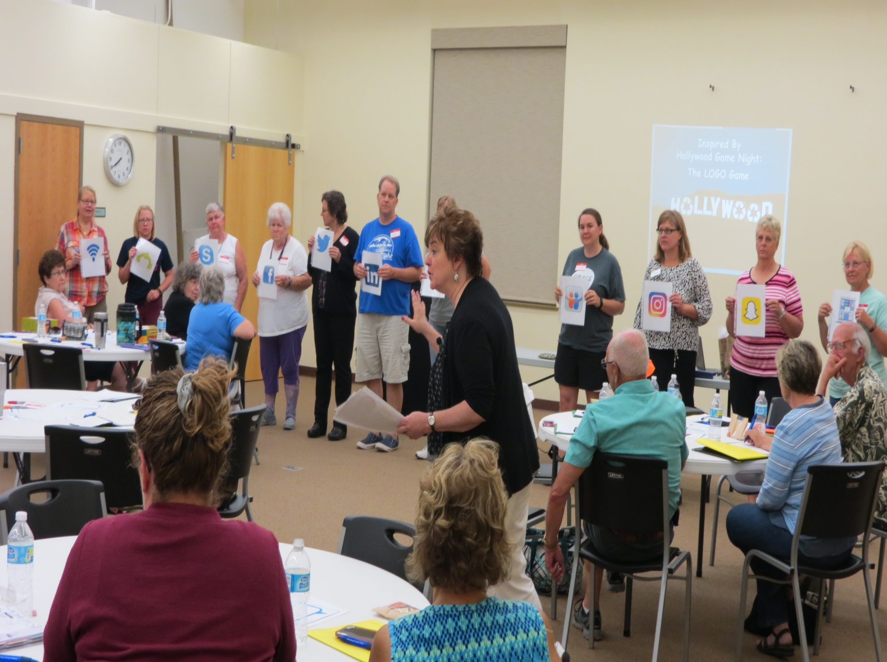
My Favorite Standard in Any State
Notes:
Love this standard ☺
This is us from last year !
Not just because it keeps me gainfully employed. Although that’s a plus ☺
Mention the BYLAWS Standard == and my suggestion to include BOARD EDUCATION in their bylaws

Slide 10

The 4 Parts To A Policy
(1) Philosophy
(2) Regulations
(3) Procedures
(4) Guidelines
Notes:
This is my favorite part of the book CREATING POLICIES FOR RESULTS because it’s such a fresh way of thinking about policy development
And it really helps to underscore the BOARD’S ROLE vs the DIRECTOR’S and the STAFF’s ROLE
We’ll take each of these in turn, using INTERLIBRARY LOAN service as our example

Slide 11
First Part: Philosophy Statement
Answers the “why” behind a program or service
Written from the customers’ point of view
Must be approved by the library board
Notes:
Are you thinking…so we actually have a PHILOSOPHY behind what we do? HAAA…☺
Of course we do, but too often it’s not discussed, not a deliberate part of the policy thought process, seldom written down
To our example, why does the community benefit from the library providing ILL service?

Slide 12
Interlibrary Loan Philosophy
Philosophy answers the “why” behind a program or service.
So Then…
Why does your library offer interlibrary loan service?
The High Anxiety Public Library values full access to information. Therefore, our library provides interlibrary loan service for all residents of our funding jurisdiction.
Notes:
ASK AUDIENCE FIRST ===

Slide 13
Second Part: Regulations
Answers “what: “what do patrons need to know in order to use library services and/or take part in library programming
Specific, written “rules of the road” keeping logic and customer service front-and-center
Must be approved by the library board
Notes:
The most common parts of any policy—you’ll always find these in abundance! Not so much the other parts
Think of a board game
And because REGULATIONS directly affect patron access to the library building, to the programming, to the services, it is rightfully the board’s role to approve REGS
Use ILL Service and ask audience for some REGULATIONS BEFORE MOVING TO NEXT SLIDE

Slide 14
ILL Regulations
High Anxiety Public Library values full access to information. Therefore, our library provides interlibrary loan services for all residents of our funding jurisdiction.
Patrons need to understand that there may be fees assessed by the lending library
Patrons may have up to 5 items on request through ILL at any one time
Patrons will be charged for loss or damage to ILL materials
Notes:
ASK AUDIENCE FIRST ===

Slide 15
Third Part: Procedures
Also answers “what:” but what does the staff need to know and do in order to provide services and programming
Written, step-by-step instructions detailing the tasks the staff should perform to support the service
Written by management & staff
Procedures should not be reviewed or approved
by the board
Notes:
This is easily and often confused = making that distinction between POLICY REGS and POLICY PROCEDURES
Use ILL Service as the example and ask audience for some ILL PROCEDURES BEFORE MOVING TO NEXT SLIDE

Slide 16
ILL Procedures…
Search Strategy 2: If not found in local catalog, search in Kansas Library Catalog (ShareIt) and process the request using approved procedures
Search Strategy 3: If not found in Kansas Library Catalog, search OCLC WorldCat and process the request using approved procedures
Search Strategy 1: Search local library catalog (NExpress) for the item to verify ownership
Notes:
ASK AUDIENCE FIRST ===

Slide 17
Fourth Part: Guidelines
Speaks to “best practice”
Leads the staff in finding the most efficient and effective ways to implement the policy in all its parts
Keeps customer service front-and-center
Guidelines can be shared with the board, but do not need to be approved by the board
Notes:
Along with the PHILOSOPHY STATEMENT, I’ll wager this 4th part of a policy is usually lacking. Hardly ever shows up, at least in writing.
Best practice might show up in “the doing,” in staff behavior and customer service. In meeting and greeting and assisting people who choose to use the library and all it offers.
But what if these kinds of best practices were actually written down and included in our policy manuals?
Use ILL Service as example and ask audience for ILL GUIDELINES BEFORE MOVING TO NEXT SLIDE

Slide 18
ILL Guidelines…
Patrons of all ages are eligible to use ILL service
All staff will be trained in ILL procedures and able to provide the service during all library hours
Staff will continually develop and encourage new approaches to providing the service, using new technologies
Notes:
ASK AUDIENCE FIRST ===

Slide 19
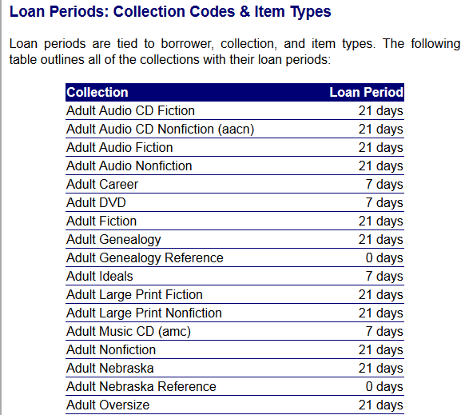
Regulation Overload

Slide 20
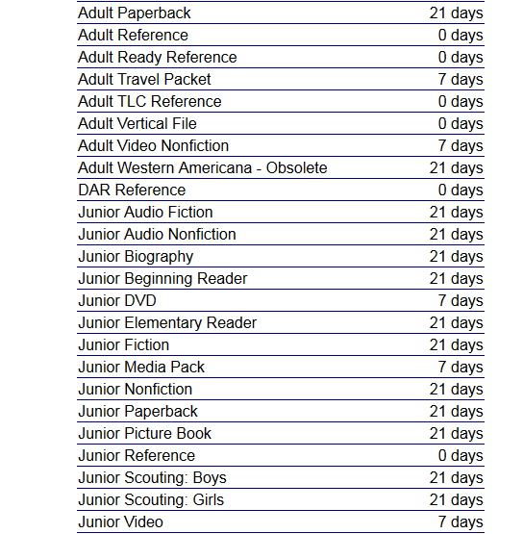
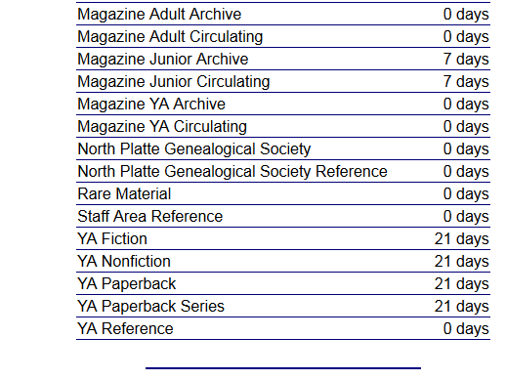

Slide 21

Reinforcing 4 Parts of a Policy
Philosophy
Regulations
Procedures
Guidelines
Notes:
ASK AUDIENCE TO USE TABLE SIGNS ☺
So to Reinforce the 4 Parts of a Policy == PHILOSOPHY / REGS / PROCEDURES / GUIDELINES
I have examples across many different policy topics … we’re letting go of ILL here and looking at other policy topics

Slide 22
Mediapolis (IA) Collections … Which part of the policy is this?
Mediapolis Public Library strives to provide books and other materials of value and interest, for information and enlightenment, for all people in the community. The library attempts to maintain a collection of carefully selected representative book and non-book materials.
It is the responsibility of the library to give full meaning to the freedom to read, and will attempt to do so by providing books that enrich the quality of thought and expression.
Library materials will never be excluded because of the race or nationality, or the social, political, or religious view of the authors. The library will try to provide materials representing all points of view concerning current issues at the local and national level…
Notes:
From Mediapolis PL
A nice example of their PHILOSOPHY behind building and providing access to the library’s COLLECTION
Some really important ideas here
Access for all ages
Striving for a balanced collection by including all points of view
Supporting intellectual freedom
Yours might be worded differently, maybe shorter, maybe longer. But I hope you can see that stating a PHILOSOPHY leads library boards and staff to supporting public library principles
PLUS:
INSTRUCTIONAL == for the benefit of new trustees for whom it will take awhile to familiar with the ins-and-outs as seasoned trustees
STORYTELLING == are libraries ever questioned ?? Practices ever questioned ?? Orange City situation from March
These PHILOSOPY statements become your TALKING POINTS = your ELEVATOR SPEECH ☺

Slide 23
Public Internet … Which part of the policy is this?
Staff will record daily Internet uses, then dispose of the daily sign-in sheets at the end of every business day
Staff will announce library closing hours 15 minutes prior to closing to ensure that Internet users finish their session in a timely manner
Staff will maintain current fact sheets, guides, and promos in the display holders next to all public computers
Notes:
Not associated with any real library, this is an example of possible INTERNET POLICY == PROCEDURES for staff
Because frankly I couldn’t find any !! So I came up with these possible PROCEDURES for in the area of INTERNET USE POLICY
And if you can think of others, I’m all ears, I’d love to have more to add

Slide 24
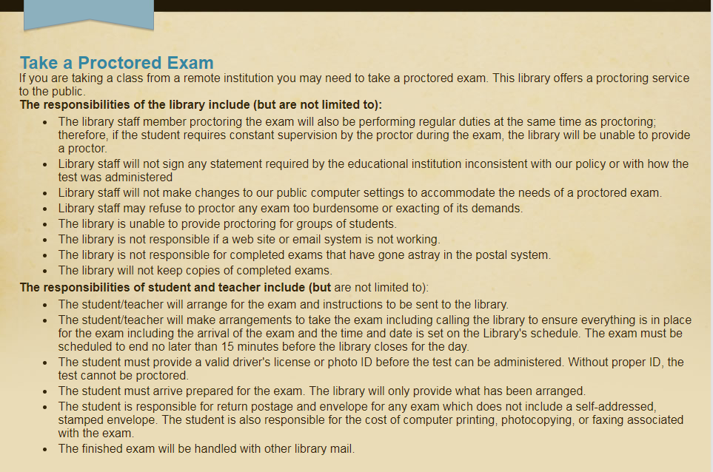
Spirit Lake (IA) Public Library Test Proctoring … Which part of the policy is this?
Notes:
From Spirit Lake PL, regulations behind the library’s test proctoring service

Slide 25
Atlantic (IA) Public Library Circulation … Which part of the policy is this?
RENEWING ITEMS: Staff can change the due date for the following reasons:
Patrons will not be able to make it in due to weather or illness
Patrons have been sick or in the hospital, and unable to make contact with the library
Patron has lost the item but would like a little extra time to look for it
Patron has an item checked out, but it has a missing piece
In these instances, library staff can change the due date to add an additional two weeks.
Notes:
Atlantic PL === here Atlantic has identified some GUIDELINES for their CIRCULATION POLICIES
You can see how these GUIDELINES speak to BEST PRACTICE
Read through example

Slide 26
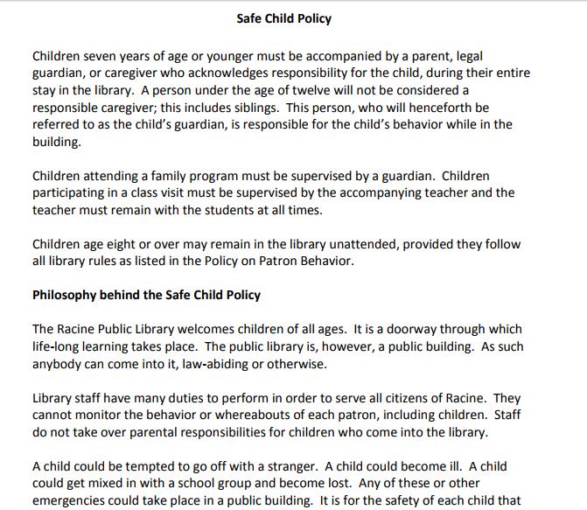
Which part of the policy is this?
Racine (WI) Public Library
http://www.racinelibrary.info/policies-a-z/
Notes:
Racine Wis ☺
Combination of both REGS and PHILOSOPHY
Read from the second half PHILOSOPHY BEHIND SAFE CHILD POLICY

Slide 27
Does city government have a role in determining policies for the city library ??
Notes:
Audience Q

Slide 28
Does City Government Have a Role? We Think Yes ☺
City Employees …
HR, Salary Scales, Benefits, etc.
Expense Reimbursement
Holiday Closings
Inclement Weather Closings
Notes:
We say yes, to some extent. Not nearly with the same level of RESPONSIBILITY that LIBRARY BOARDS have. It’s just that the policy decisions that the city has made for other city workers == for other city departments == might very logically apply to the PUBLIC LIBRARY
These are areas where the CITY might have some influence over library policies
Where you’ll find logical connections with other city workers
If these things have been determined for other city workers == are library staff included ??

Slide 29
Policy Involvement
Board’s Role
Director’s Role
Understands the broader implications
Ensures legal compliance
Ensures ethical compliance
Approves policy philosophy and regulations
Brings policy review to the board’s attention
Drafts new policies for new issues
Acts as technical advisor to the board
Shares policies with the staff and ensures that policies are upheld
Notes:
I always felt that POLICY DISCUSSIONS with my former board == Regional System in Iowa == were our best COLLABORATIONS ☺
Always a very good give-and-take, aided by directors bringing a draft or revision ideas to the board. Let the conversation ensue ☺
Boards have a great deal of authority over the library’s policies.
Broader implications ? I think there’s a tendency to write policies in the aggravation of the moment. Someone got on your last nerve with a cell phone call and “that’s it!” You write a policy that tries to address difficult patrons and rude behavior. And next months you have a policy that says “No Cell Phones, Leave All Cell Phones In Your Vehicles.” ☺
Legal compliance = Library boards are a PUBLIC BODY and must be in compliance with Iowa’s OPEN MEETINGS LAWS
When boards are in the position to HIRE a LIBRARY DIRECTOR, they must be in compliance with ADA EMPLOYMENT LAWS
Ethical compliance = Defending intellectual freedom. Being a good steward of the library’s budget. Another policy topic that comes up occassionally as libraries are looking for samples = INVESTMENT POLICY & CREDIT CARD
In both cases best to follow city hall ☺
Consistent meeting attendance, taking care to not be ABSENT more than you are PRESENT at board meetings ☺
The board oversees and officially adopts POLICIES = = revises and evaluates them also. Boards are doing that by working together with the LIBRARY DIRECTOR
Step through DIRECTOR points

Slide 30

The Staff’s Role
Understand the policy development process
Make suggestions for improvements, changes, ask questions
Explain and implement the policies
Notes:
One of the best ways to update job descriptions is to ask the person doing the job !! Ask for that input == first hand knowledge from the person who is doing the job
Same applies here == staff should feel free to make suggestions to the POLICY PARTS that they can most directly affect
REGULATIONS that they are expected to explain and enforce
And PROCEDURES which they are writing for themselves ☺
They’re the ones on the front lines, on the service desks, interacting with patrons. They hear it if patrons are frustrated by rules and regulations, so staff should bring those things up for discussion

Slide 31

Public Policies Publically Accessible
Kansas advises:
“We see the parts of the policy—Philosophy and Regulations—that the Board approves as the parts that the public has a right to see.
So we encourage those to be posted to the library’s website. And if printed, kept in a separate notebook from the Procedures and Guidelines.”

Slide 32


Kansas Specifics

Slide 33

Policy Pet Peeves
Do you have any policy pet peeves?
Do you think your patrons have any?
Notes:
I may have already revealed my bias about ILL coming to a crashing halt when the normal ILL staffer is on vacation
Also for me = = INCLEMENT WEATHER and HOLIDAYS
What about you = and your customers? Tough question? What do libraries do in terms of policy that really bug our customers if we were to actually ask them!
All together large group

Slide 34

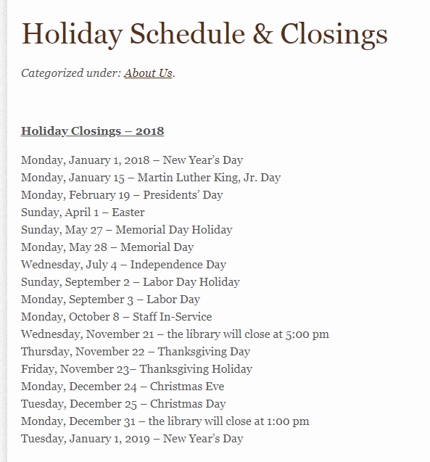
Notes:
@ Basehor == They’ve decided—and DOCUMENTED—which holidays the library observes, when the library will be closed …

Slide 35
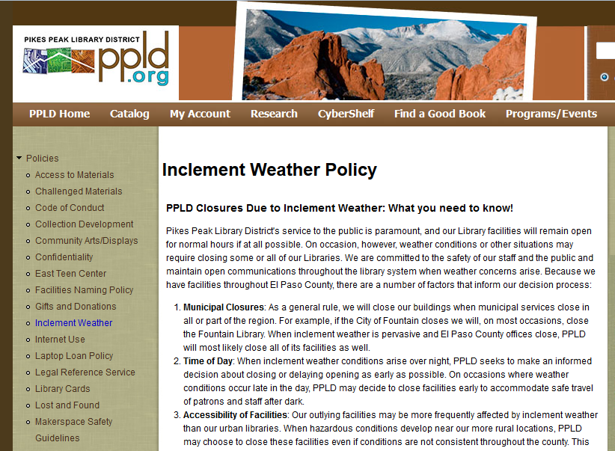
http://ppld.org/inclement-weather-policy
Notes:
Another pet peeve of mine ☹
This from Pikes Peak in Colorado addresses how to decide inclement weather closings

Slide 36

Path Less
Traveled Policies

Slide 37
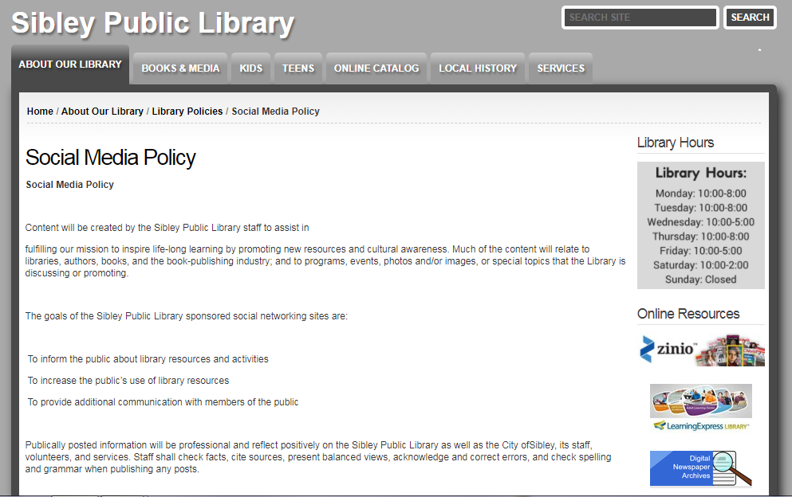
http://www.sibley.lib.ia.us/library-information/policies/social-media-policy
Notes:
Kenosha
Sibley also has one and other larger libraries, but seldom found in small town libraries. And yet, small town libs are just as active on SOCIAL MEDIA as larger cities
FROM KENOSHA “…Social media such as social networks, blogs, bulletin boards, and personalized web sites are changing the way we communicate and interact both at home and in the workplace. The purpose of these sites is to engage in dialogue, provide and exchange information, and build understanding.
While we recognize the benefits of using social media and respect your right to do so, we also realize there are certain risks involved. Because online postings may conflict with the interests of Kenosha Public Library and its patrons, we have adopted the following policy regarding the relationship between KPL and KPL staff personal social media accounts.

Slide 38
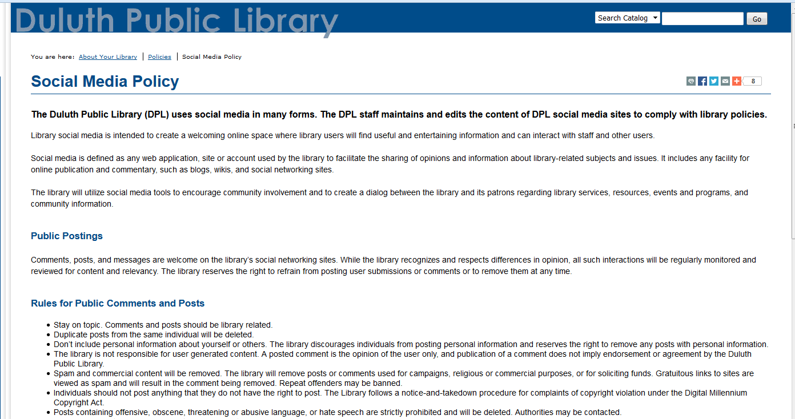
http://www.duluth.lib.mn.us/about-your-library/policies/social-media-policy/
Notes:
Example == SOCIAL MEDIA POLICY
While social media is no longer new in our lives, no longer that new in libraries either == what might be new is that maybe your library hasn’t looked at social media as a policy issue.
Dubuque PL has a social media policy as well. I’ve used Dubuque as an example before, but I couldn’t readily find it again…so this one from Duluth (MN) is a good one…
INCLUDES: How and why the staff uses Facebook, for instance. As well as the appropriateness of the public commenting on the library’s Facebook page
FROM DULUTH: Library social media is intended to create a welcoming online space where library users will find useful and entertaining information and can interact with staff and other users … to encourage community involvement and to create a dialog between the library and its patrons regarding library services, resources, events and programs, and community information.
Comments, posts, and messages are welcome on the library’s social networking sites. While the library recognizes and respects differences in opinion, all such interactions will be regularly monitored and reviewed for content and relevancy. The library reserves the right to refrain from posting user submissions or comments or to remove them at any time.
Social media is defined as any web application, site or account used by the library to facilitate the sharing of opinions and information about library-related subjects and issues. It includes any facility for online publication and commentary, such as blogs, wikis, and social networking sites.

Slide 39
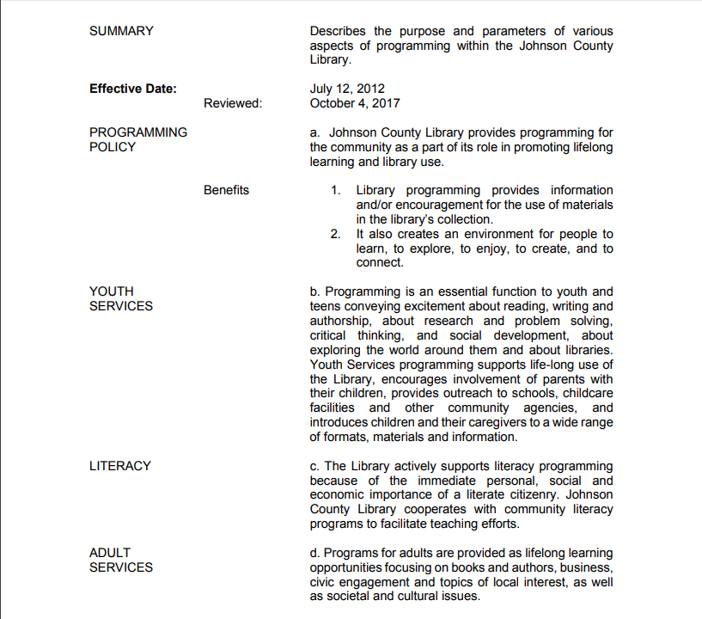


Slide 40
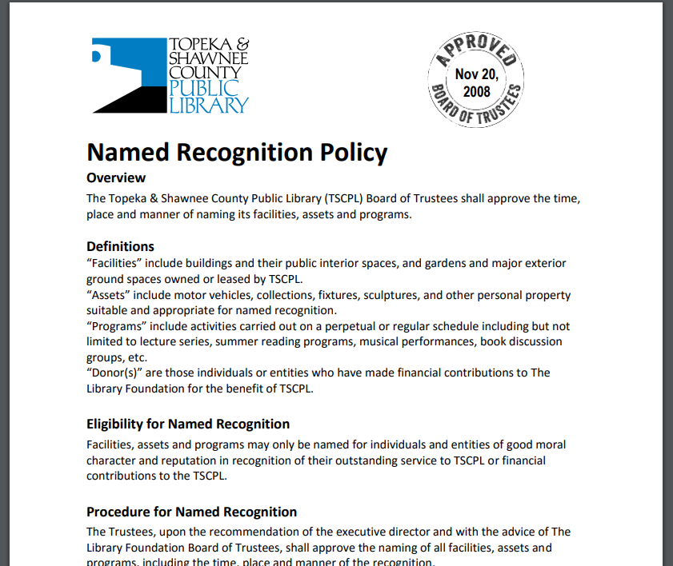
https://tscpl.org/about/policies

Slide 41

Policy Blitz
Policy Blitz
Notes:
Winding up with a look at some more noteworthy policies and where to find samples

Slide 42

Notes:
@ Younkers PL in New York

Slide 43
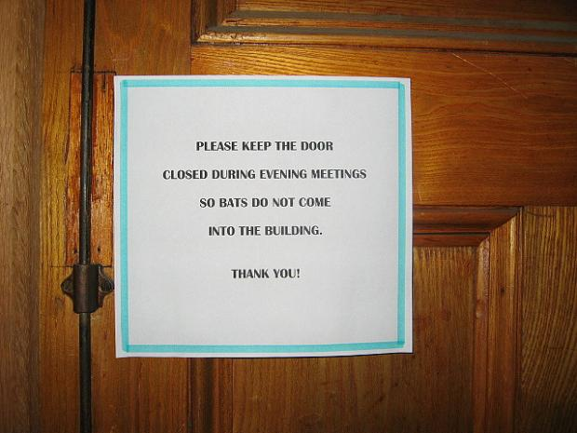
Notes:
@ Charlemonte Public Library in Massachusetts

Slide 44
Actual Library Policy… True or False?
Wild animals are not allowed in the building unless properly contained and accompanied by a veterinarian certificate that clears the animal of diseases including rabies. Service animals are always allowed in the building.
Notes:
TRUE == This is a Nebraska library

Slide 45
Actual Library Policy… True or False?
Powdered gelatin packets must not be opened in the library or sprinkled on any of the library’s public computers
Notes:
TRUE == I honestly can’t remember what state this came from, but TRUE

Slide 46
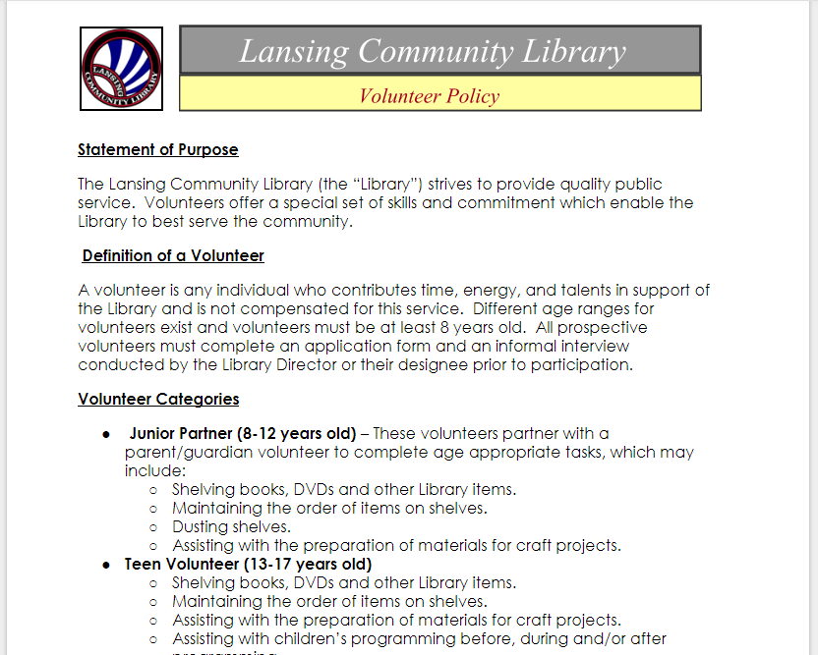
http://lansing.mykansaslibrary.org/policies
Notes:
Lansing Kansas ☺
VOLUNTEERS Policy

Slide 47
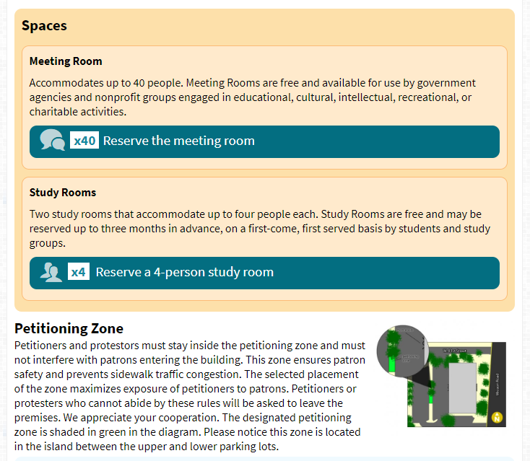

Notes:
CORNITH KANSAS
I like this it strikes me as a GUIDELINE behind their MEETING ROOM POLICY ☺
This presents REGS for reserving the library’s meeting room
But in addition to the REGS, Cornith provides a 360@ photo of the meeting space
And maybe your library isn’t big enough to have a couple of public meeting rooms that subdivide
PHOTOS of how the meeting room could be set up
So because GUIDELINES speak to BEST PRACTICE, what a nice practice to provide that extra information about choosing different room arrangements

Slide 48
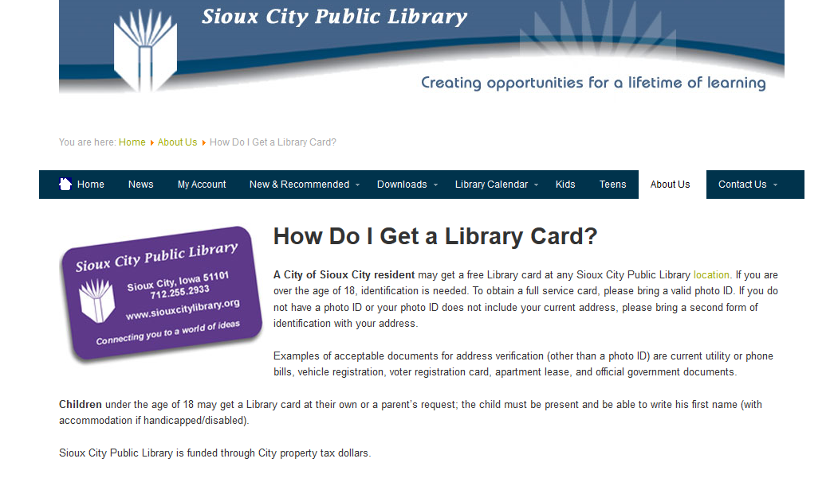
Defining Patrons, Defining Service
Notes:
Sioux City Public Library has been DEFINING PATRONS and DEFINING SERVICE for decades. And they’re not alone in having these policies in place, other cities are doing this also. Not nearly enough cities are doing this, though. Which is why we want to showcase Sioux City’s model. There’s lots to be learned from here ☺
On their website, they’ve clearly defined who is eligible for full-service Sioux City Library card. They spell out ages, residency, they address Open Access borrowers.
Now this screen shot is an abbreviated version of the full CIRCULATION POLICY that the board adopted. The full CIRC POLICY more completely defines various patron types who can receive a card without paying for one. That complete policy is in your packets, as is this shorter version. This is more of a promotional piece…
One more note = the last line that this slide captured reads SIOUX CITY PUBLIC LIBRARY IS FUNDED THROUGH CITY PROPERTY TAX DOLLARS!
That one line spotlights that SCPL is a city service, tax-funded. NOT FREE, but instead a COMMUNITY INVESTMENT
Ask audience == how many of your libraries have ever use a similar phrase in any of your promotions? Website? Newsletters? Flyers?

Slide 49
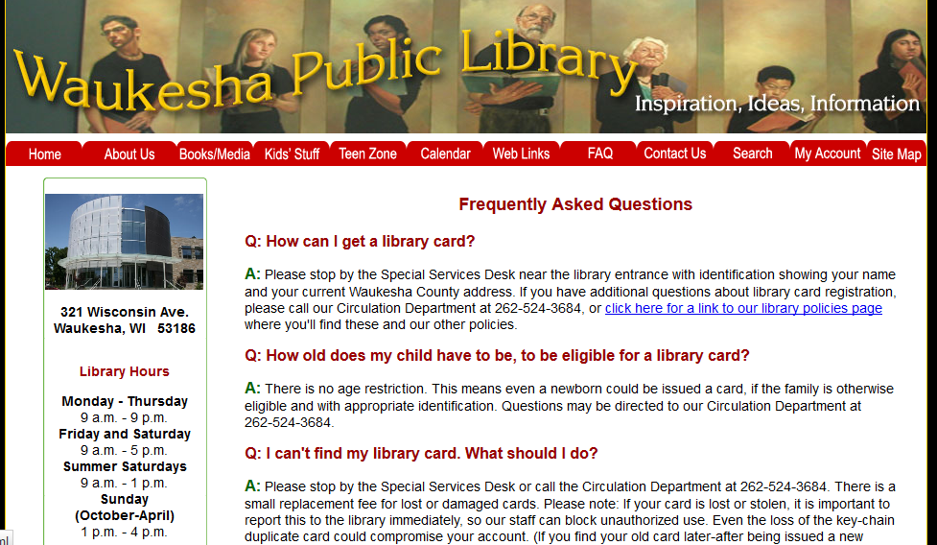
http://www.waukesha.lib.wi.us/about/faqs.shtml
Notes:
I like this because of the FAQ approach == it’s a friendly way of relaying policy information because the ANSWERS to people’s FREQUENTLY ASKED QUESTIONS are usually policy decisions ☺
Still good to post your library policies in their entirety on your website. But this kind of FAQ display is a nice visual way of sharing policy information and doing public education at the same time

Slide 50
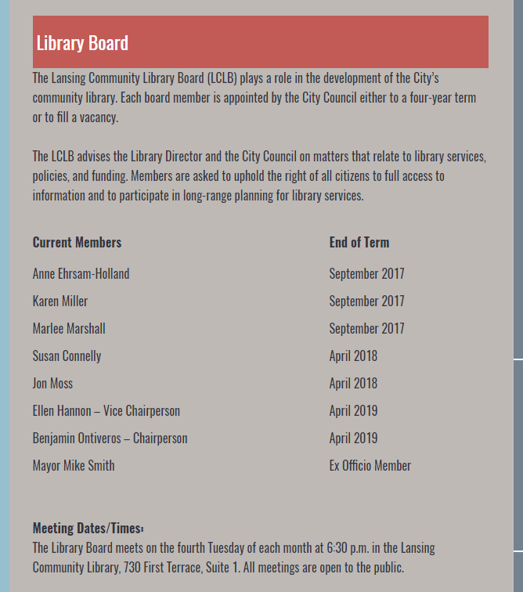

http://lansing.mykansaslibrary.org/about-us/library-staff
Notes:
From Lansing Kansas
I’m not sure if this is a POLICY or a part of one, but I like this because I’ve never seen this before
In my experience, library trustees are often mystified by when they were appointed to the board and when their term is up
Voila === Lansing Kansas PL added that helpful intell to their website ☺

Slide 51

From Halifax (Canada) Public Libraries
Today I Bent a Rule (or wanted to)
Found on WebJunction
Notes:
ARTICLE for AUDIENCE ☺

Slide 52

Find Sample Policies
Northeast Kansas Library System
http://policies.nekls.org
WebJunction
www.webjunction.org
American Library Association
www.ala.org
Public Library Association
www.pla.org
Notes:
Here are some good library websites for policy samples
Explain what’s unique or what you’d find with each one
ALA = intellectual freedom documents like FREEDOM TO READ, FREEDOM TO VIEW, and interpretations…
WebJunction = mostly computer related, nice WIFI wireless access here; plus a portal to lots elsewhere
Posting policies on library’s website == best to choose a select assortment
ASK AUDIENCE = WHICH ONES ARE ON THEIR WEBSITES?
Unattended children
Meeting rooms
New users, new library cards
“What Parents Will Want to Know”

Slide 53
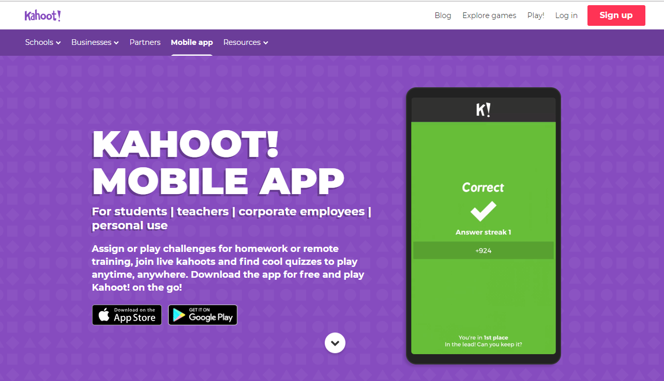
Notes:
If time, try playing the Policies For Results Game ☺
LOGIN = BJMcKewon
PASSWORD = kahoot0902
GO TO MY KAHOOTS
PLAY and game will display the PIN NUMBER FOR THE AUDIENCE

Slide 54

Reactions?
What Will You Do With Policies For Results @ Your Library?
Notes:
One of my favorite MAXINE cartoons says:
I find I organize things into 3 categories
(1) Things I won’t do today
(2) Things I won’t do tomorrow
(3) Things I’ll never do
But’s that not you !!
Now that you’ve heard the ideas behind POLICIES FOR RESULTS = = and the 4 PARTS OF A POLICY ==
Do you think you could you take a crack at this? Formatting your policies according to the 4 Parts?

Slide 55
Policies For Results
That’s Our Time Thanks For Attending!

Slide 56
? Has Your Library Addressed ?
Education Expenses
Theft
Reference Service
Inclement Weather & Holiday Closings
Public Safety including safe child
Social Networking
Programming
New Collection Formats
like eBooks, Hoopla
Wireless Internet
Volunteers
Amenities—coffee, for instance ☺
Notes:
FLIP TO POLL Q (Multiple Choice) and ASK = How many of you have of these policies have you addressed?
Public Safety could include
safe child
emergency evacuations
safety equipment inspections
OSHA regs

Slide 57
Clintonville (WI) Public Library http://www.clintonvillelibrary.org/
Business Travel Expense
The Library will reimburse employees for reasonable business travel expenses incurred while on assignments away from the normal work location. The Library Director must approve all business travel in advance. When approved, the Library will reimburse the actual costs of travel, car rentals, meals, lodging, and other expenses directly related to accomplishing business travel objectives. Employees renting a vehicle while traveling on business shall purchase any optional insurance the rental companies may offer.
Employees who are involved in an accident while traveling on business must promptly report the incident to their immediate supervisor. Vehicles owned, leased, or rented by City of Clintonville may not be used for personal use without prior approval.
Cash advances to cover reasonable anticipated expenses may be made to employees, after travel has been approved. Employees should submit a written request to the Library Director when travel advances are needed.
Mileage Reimbursement
Use of a personal vehicle for Library business will be reimbursed at the current federal mileage reimbursement rate per mile. The voucher shall be given to the Library Director for payment. A City vehicle shall be used if available.
Notes:
Example == specifics regarding STAFF EDUCATION POLICY

Slide 58
4 Tests of Legally Enforceable Policies
Does the policy conform to current law? (local, state, federal)
Is the policy reasonable?
Is the policy non-discriminatory and fairly applied to everyone?
Are the regulations measureable?
Notes:
@ this point, only offer brief references, because WORK GROUPS will try their hand at this.
Read from pages POLICIES FOR RESULTS book
CURRENT LAW == Open meetings is a common one. Equal opportunity employment, which surrounds how your library board as a public body recruits, interviews and hires library directors in Nebraska. Including JOB DESCRIPTIONS…
REASONABLE ==
NON-DISCRIMINATORY == do your board members receive perks that other people don’t? Or Friends Group members? Or the mayor?
MEASUREABLE == language that is too arbitrary

