Slide 1

2018 state of the System
Notes:
Early Kansans were concerned with women’s equality, and granted them the right to vote in school district elections as early as 1861. By 1887, women were participating in municipal elections, and by 1912 Kansas had finally extended them equal voting rights—a full eight years before the 19th amendment was ratified
http://mentalfloss.com/article/71618/25-homespun-facts-about-Kansas
Kansas has had statutes on libraries since 1951 (65 years), with System law passing in 1965. Kansas Statues K.S.A. 75-2547 and 75-2548 established seven regional systems to help local libraries provide library services to all citizens of the state. This has led to a rich and robust tradition and practice of resource sharing which benefits every citizens in Kansas.

Slide 2
“The library is central to our free society. It is a critical element in the free exchange of information at the heart of our democracy.”
-Vartan Gregorian
Notes:
Vartan Gregorian is the Presdent of the Carnegie Corporation of New York
A 2018 Pew Research Center study shows that 94% of Americans 16 and olders said that the library was beneficial to the quality of line in a community.

Slide 3
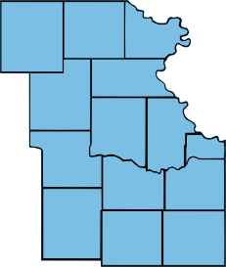
Northeast Kansas Library System
Atchison
Brown
Doniphan
Douglas
Franklin
Jackson
Jefferson
Johnson
Leavenworth
Miami
Nemaha
Osage
Shawnee
Wyandotte
117 member libraries – 11 academic; 48 public; 50 schools/districts; 8 special –in the 14 counties of Northeast Kansas with a System Board of a possible 146 members.
Notes:
System Board – 117 member representative (System Representatives), 18 Executive Board members and 11 County Representatives (formerly called Governor’s Appointees.

Slide 4
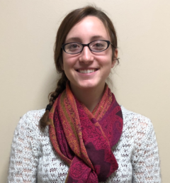
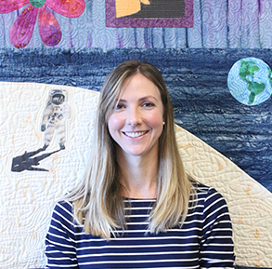
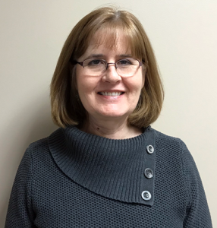
Since Last We Met
Jessi Harris
Caroline Handwork
Lisa Miller
Notes:
Personnel changes
Jessi Harris - Office Coordinator – voice of NEKLS. As our office coordinator, she keeps us organized. ILL contact for our libraries who need to get hard to find materials, our Statewide database guru and major continuing education event support.
2) Carolyn Little retired as Courier Coordinator and was ablely replaced by Caroline Handwork. as the Courier Coordinator and Executive Assistant. As courier coordinator she keeps your materials moving and works seamlessly with courier management, and as the Executive Assistant, she keeps me moving in the right direction – minutes for Exec Bd and System Bd are minor examples!
3) Finally, Lisa Miller joined NEKLS as our Financial Manager. She is new to the budget process, but worked with Mike McDonald and I to develop the budget we will talk about later this morning. I’m still not giving up QB support, but Lisa can help as well!

Slide 5
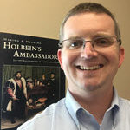
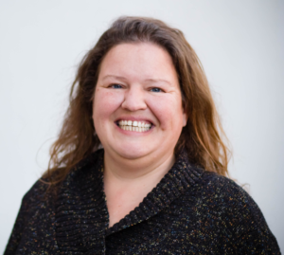
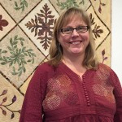
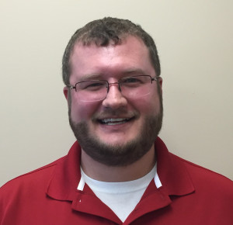
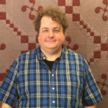
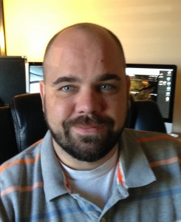
NEKLS Staff
Michael McDonald
Robin Hastings
Anna Foote
Greg Gantz
George Williams
Dan Alexander
Notes:
Mike McDonald – Library Development Consultant and major driver in the development of the Northeast Kansas Library Foundation. Developed a successful strategic planning model for libraries.
2) Anna Foote – Children’s Service & Continuing Education Consultant. She is the School Library liason, provides 6x6 and early literacy training and consulting, manages the Summer Reading program and is CE consultant extraorinaire!
3) Robin Hastings – Library Services Consultant – Hoopla and Flipster Management, Recollections: Kansas, Kansas Libraries on the Web (KLOW) websites and provides strategic planning consulting and ILL and Next support.
4) Greg Gantz – Technology Specialist – Tech support, purchasing and e-rate technical assistance. When this break, he’s the guy to call!
5) George Williams – Next Coordinator, Ill training and support, cataloging.
6) Dan Alexander – Technology Director and Next Brand Ambassador – Next support, Library website support, UX Design -User experience design (UX, UXD, UED or XD) is the process of enhancing user satisfaction with a product by improving the usability, accessibility, and pleasure provided in the interaction with the product.[ User experience design encompasses traditional human–computer interaction (HCI) design, and extends it by addressing all aspects of a product or service as perceived by users, as well as technology purchasing and assistance.

Slide 6

In 2017. . .Next had
1,045,809 | 1,629,601 | 217,609
# of books, dvds, audiobooks, and other materials in the collection | # of materials circulated | # of materials shared between NExpress libraries
Notes:
Next is a shared regional catalog with 42 public libraries, one school districts and the NEKLS System Library. By the end of the year we will be adding the Highland Community College to the consortium. Currently,

Slide 7

Notes:
Top of the Next poster – so true, and great cost avoidance for the family budget.

Slide 8

Notes:
"The idea of the bookmarks, and to a degree the poster, is that there are many different people, places, and, things to explore at the library. Most of them are right under our nose. There are many Georges and Lauras, both pretty common names, to learn about. The materials are intended to be idea or conversation starters about the library collection. For example a librarian might ask the patrons do they know who all the Georges are, are any more interesting than others to them?
By the way – George and I did not receive any remuneration for the use of our names. . .

Slide 9

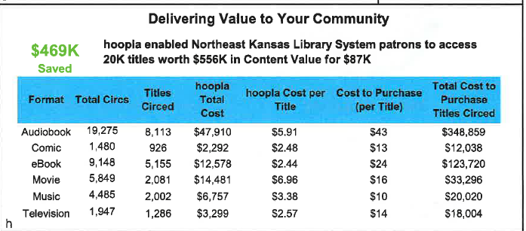
Still part of Next
Notes:
Read this slide very carefully. People were able to access $556,000 worth of material that they wanted and needed. The cost avoidance for the community was $469,000. In terms of a ratio statement – for very $1 of tax support for the library, the taxpayers were able to access $6.39 of content.

Slide 10
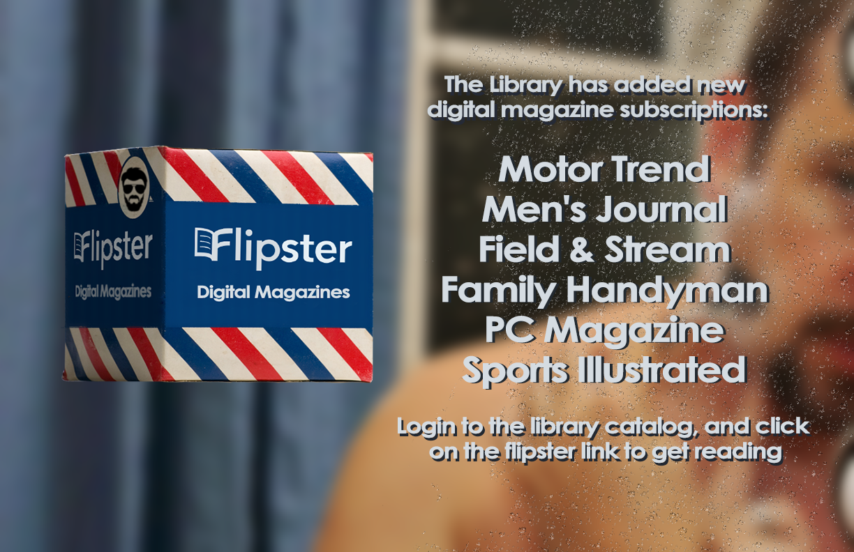
42 Different Magazines - no need to wait, no need to recycle!
In 2017 there were 3,517 downloads of magazines. At a newsstand price of $5.00 per download, the cost avoidance for NEKLS patrons was $17,585.00.
Notes:
This digital service is growing at a slower pace, but I expect the rate to increase. Flipster work well on phone, tablet or computer.

Slide 11

Coming to Next
Now LinkedIn Learning
With LinkedIn Learning, you can:
Access 6,000+ expert-led courses
Earn a certificate when you complete a course
Receive course recommendations tailored to you
Use project files and quizzes to practice while you learn
View courses anytime on your computer or phone
Learn business, creative, education and tech skills taught by expert instructors.
Notes:
This became active on August 9, 2018. Thanks to George Williams, who was able to complete the activation while on vacation!

Slide 12

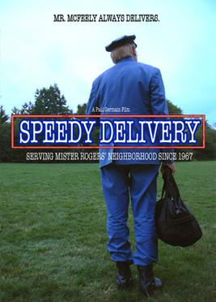
In 2017, 1,014,030 items were shipped
Average cost per item shipped – 64 cents!
Cost avoidance of at least $1,379,000 for Kansas libraries and
citizens.
Notes:
This cost avoidance was based on a average mailing cost of $2 per item if the courier was not in existence. And that’s just the cost of shipping. The dollar value of the items shipped, at a value average of $25.00 per item, is $25,350,750.00. All managed with a .7 employee.
Speedy Delivery is a 2008 documentary film directed and produced by Paul B. Germain. The film follows the life story of David Newell, better known as Mr. McFeely from the children's television show Mister Rogers' Neighborhood. Wikipedia
Initial release: April 10, 2008
Director: Paul B. Germain
Budget: 4,000 USD
Producer: Paul B. Germain
Music composed by: Bryan Senti

Slide 13

Training and Continuing Education
Youth Services Management Strategic Planning Children’s Programming
Technology Adult Services Reader’s Advisory Fundraising/Grants
Collection Development Space Planning E-Rate Storytime
Human Resources Library Policies Summer Learning Board Development
Lifelong Learning Budget & Finances Community Engagement

Slide 14


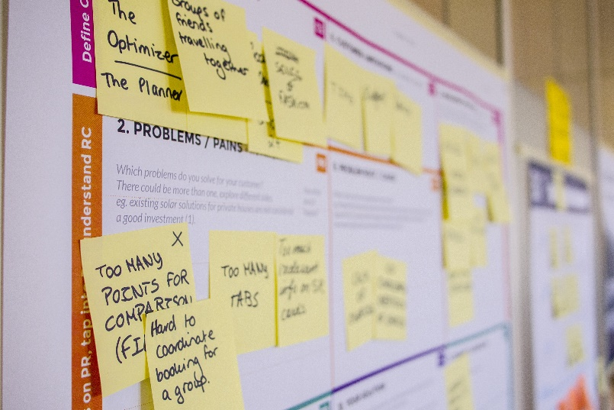
CONSULTING
Notes:
Legal consulting
Architectural Consulting
NEKLS staff consulting

Slide 15

Grants
Accreditation Grants
Hoopla Digital Service Grant
Project Outcome Grant
Subsidized Support of Kansas Library Express Cost
Subsidized Cost of Next consortium
Continuing Education Grants
Notes:
CE grants - $60,000; Hoopla Digital Service grants - $45,000; Subsidized support of Courier costs - $115,150.00, Accreditation grants - $746,000

Slide 16

COMMUNITY STORIES
Jessie is in elementary school and struggles with math and retaining her math facts. The library showed her the Floating Launchpad which had math, science and related games on it for her age group. She checked it out and now knows her math facts better than ever and didn't even realize that she was learning while having fun. The Launch Pads have become more popular this summer...for fun and education. Librarians are passionate advocates for lifelong learning.
Notes:
Formula for creating stories from Jamie LaRue –
https://www.youtube.com/watch?v=Iy0-1qjtDJY James LaRue tells “how to create a story”
Steps – Real person, the Problem (the hook), the Library as SUPPORTING character, provide one fact, and end with the “phrase that pays”

Slide 17
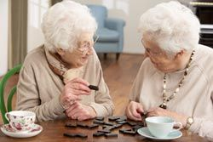
Lillian and Jane are two " long past retirement age" residents of our local retirement village. They both love to read but are basically confined to quarters, nowadays. One of our staff members introduced them to audio books and interlibrary loans and offered to deliver items to them. Now, both the ladies can enjoy their favorite past time...reading and/or listening to their favorite authors. Libraries transform lives

Slide 18

Northeast Kansas Library Foundation, Inc.
Mission Statement:
The Northeast Kansas Library Foundation equips and supports its member libraries in creating a culture of philanthropy in their communities.

Slide 19
OUR VALUES
Equal Access
Respect for member libraries
Respect for people
Stewardship
Integrity
Continuous Improvement
Resource Sharing
Communication
Participation
Innovation
Confidentiality
Community Engagement
Sustainability

Slide 20
What’s Next for your library?

