Slide 1

2018
Super Volunteers

Slide 2
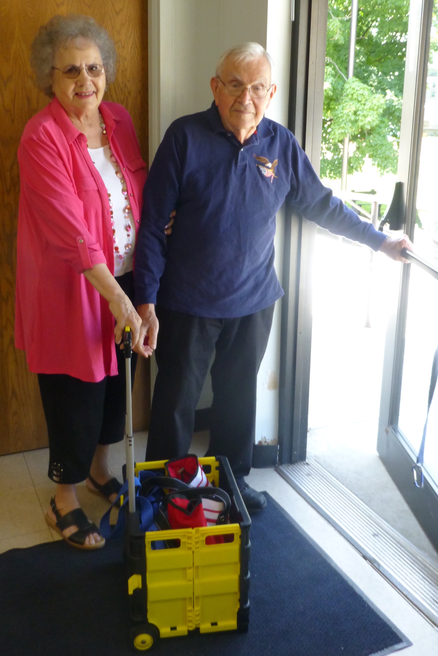
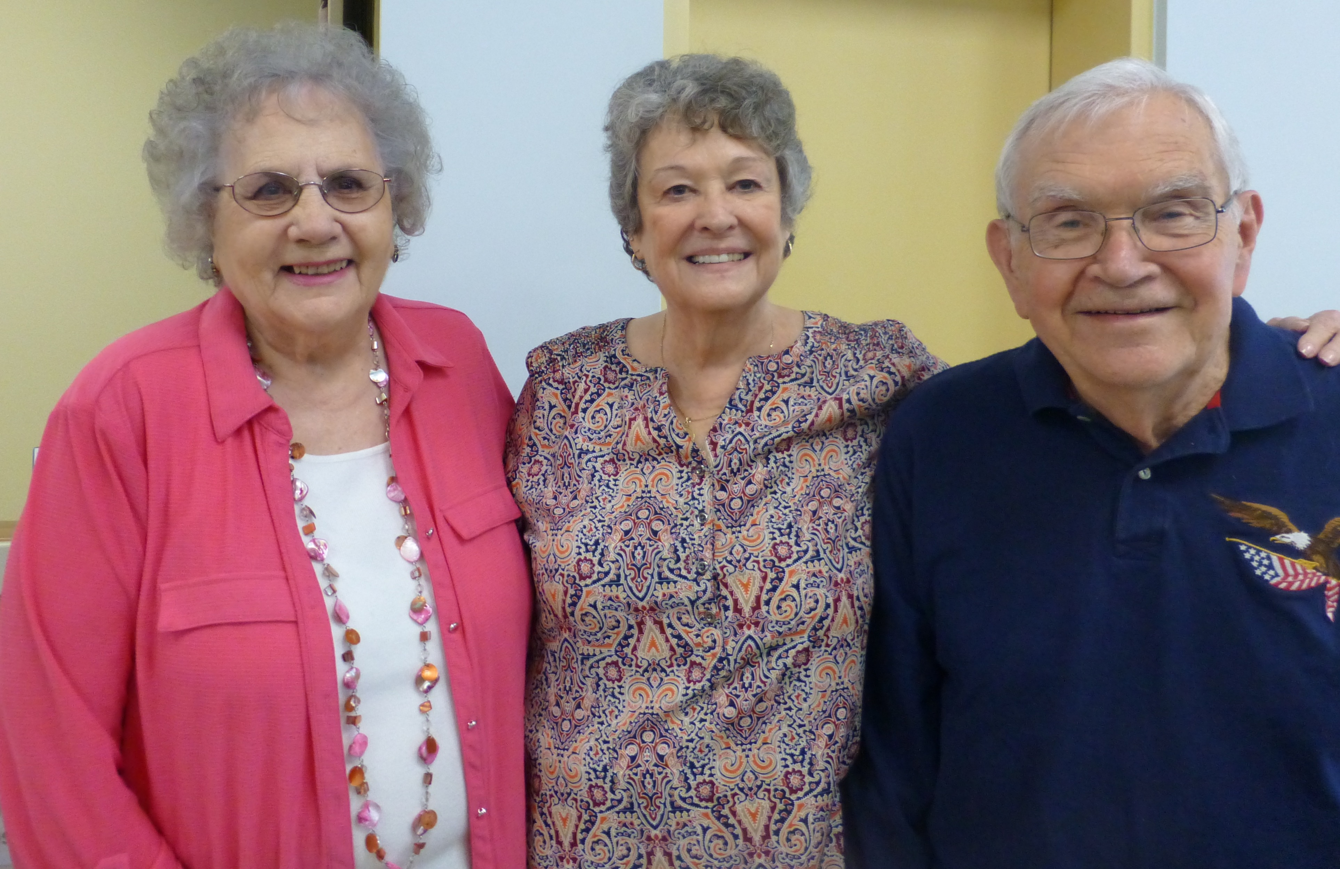
George and JoAnn Kautz
Atchison Public Library

Slide 3
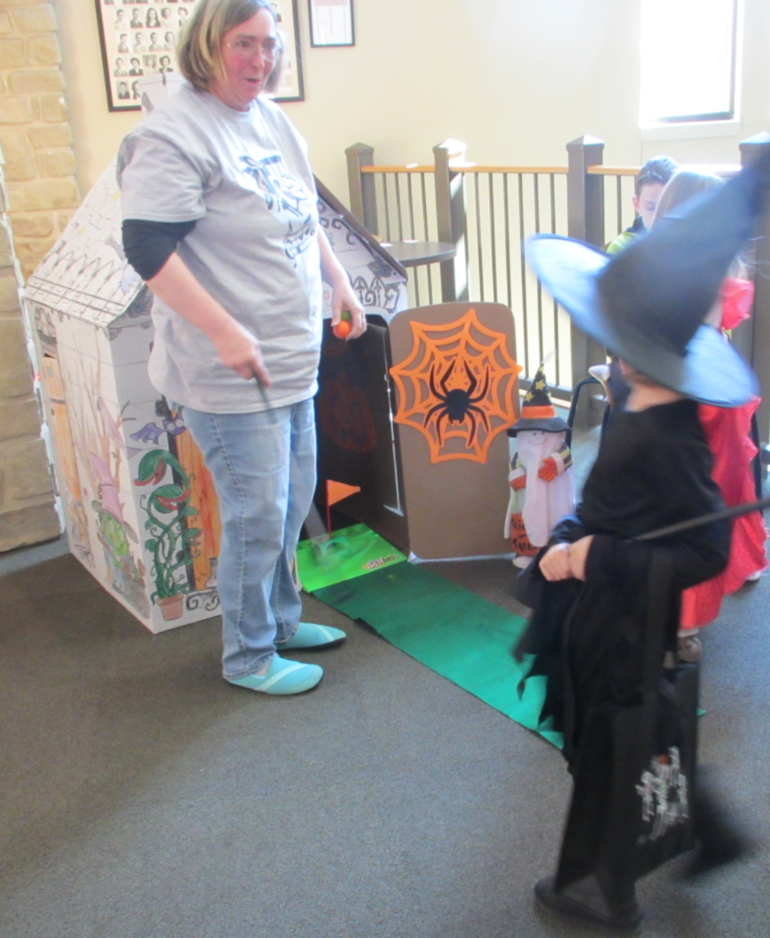
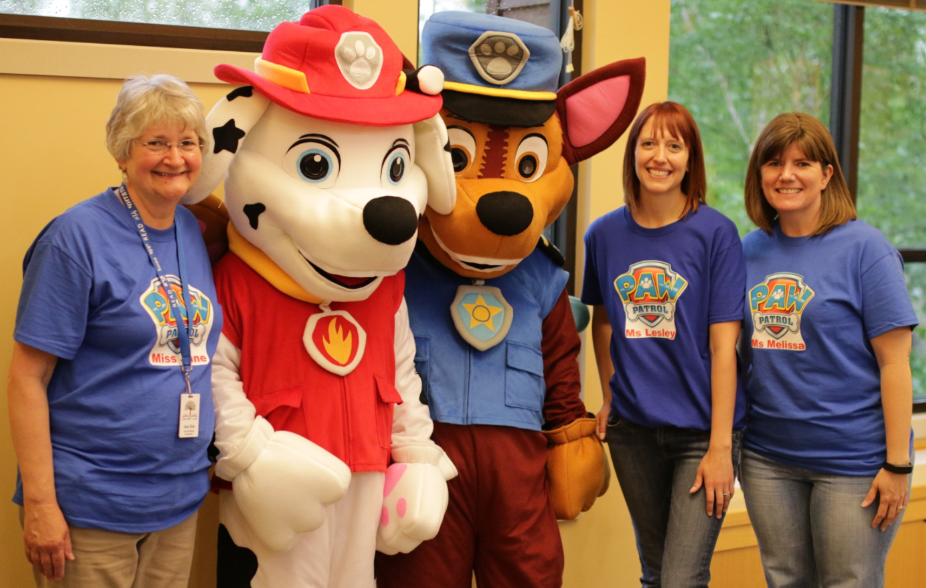
Patricia Welicky
Bonner Springs City Library

Slide 4
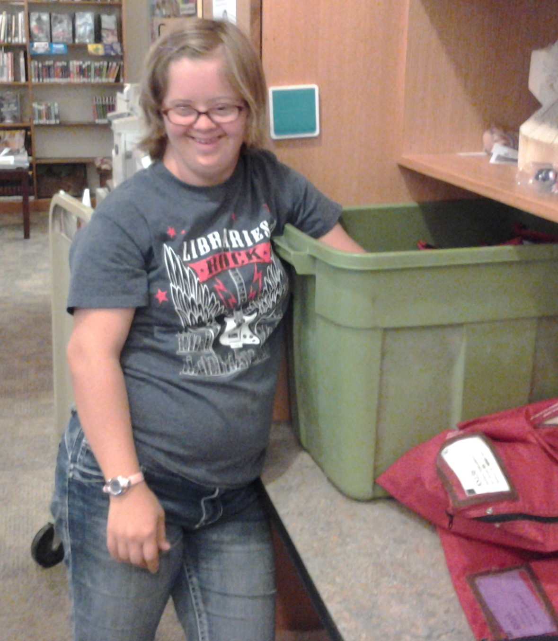
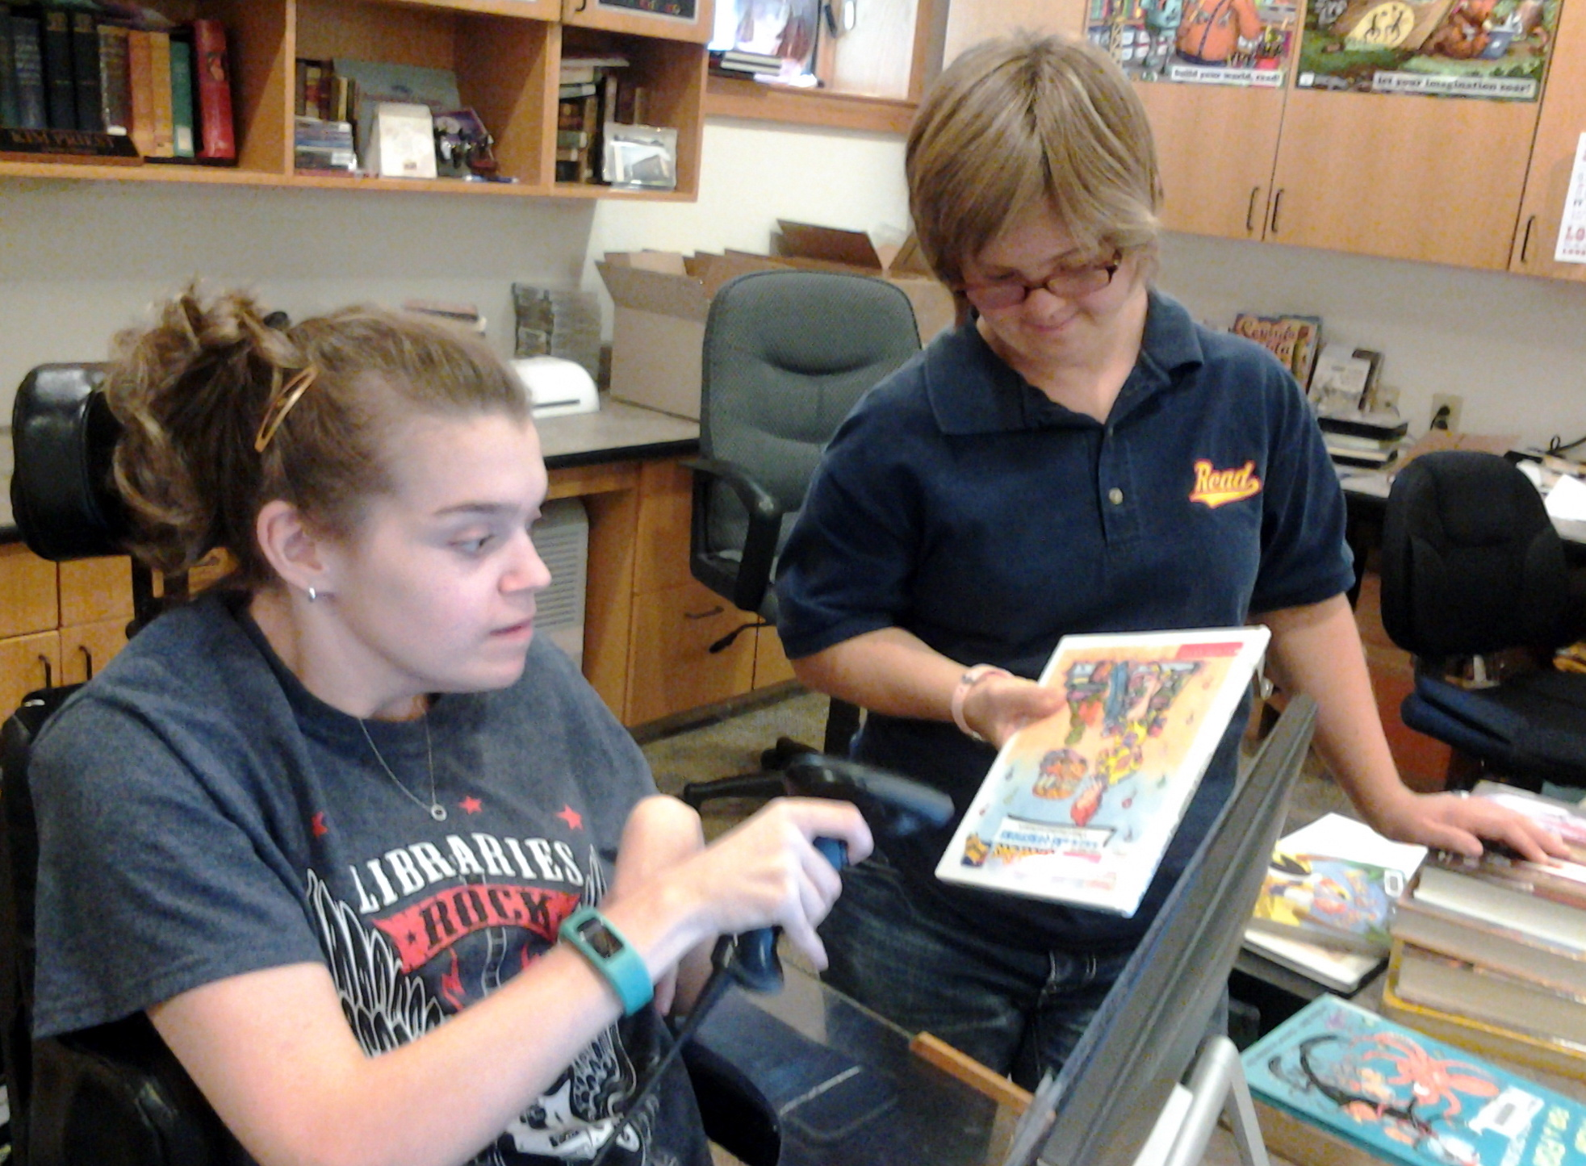
Jill Strahm
Mary Cotton Public Library, Sabetha

Slide 5
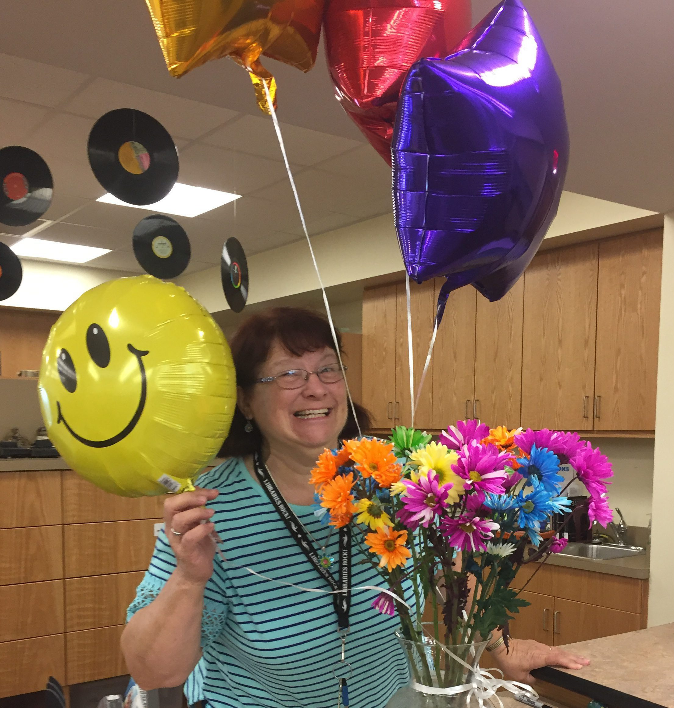
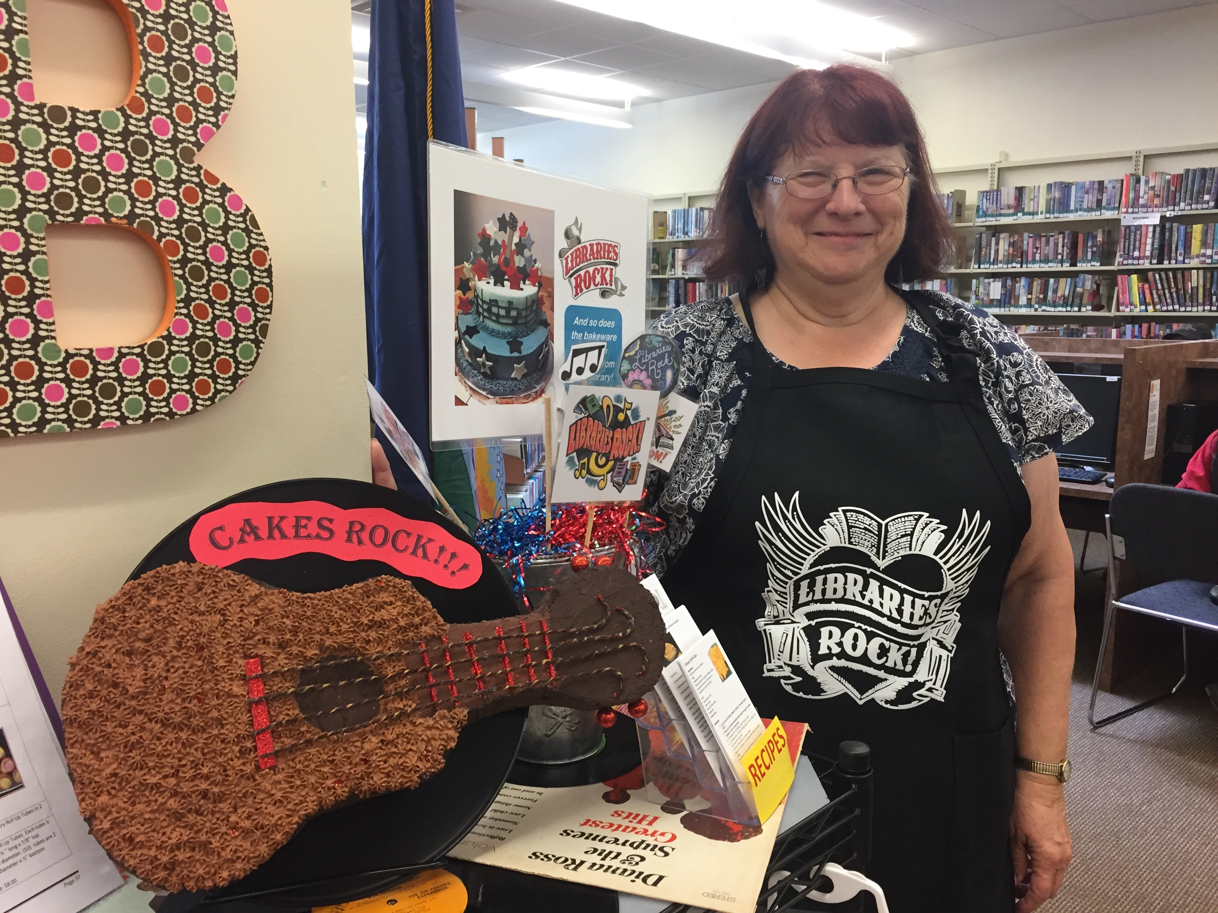
Lynn Drake
Overbrook Public Library

Slide 6
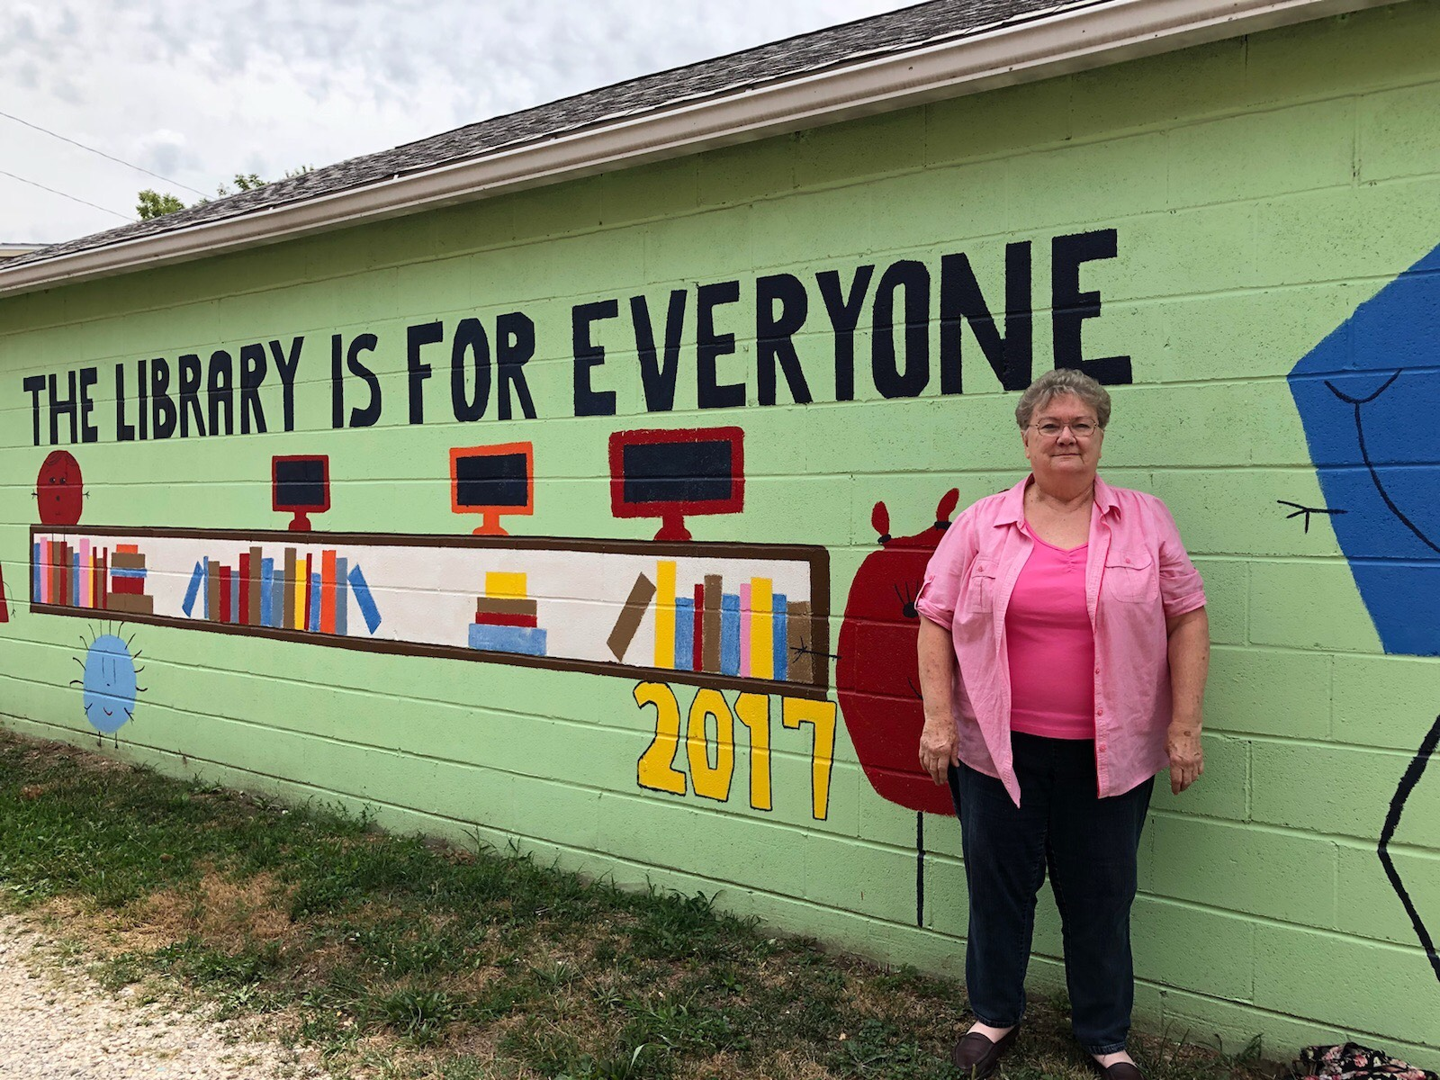
Carol Wills
Pomona Community Library

Slide 7
Thank you,
Super Volunteers!

