Slide 1
Free Speech in an Information-Overloaded World
Dr. Jim Walther,
Assistant Professor
ESU, School of Library and Information Management

Slide 2
A few free words …
The power to mould the future of the Republic will be in the hands of the journalists of future generations.
Liberty is the only thing you can’t have unless you give it to others.

Slide 3
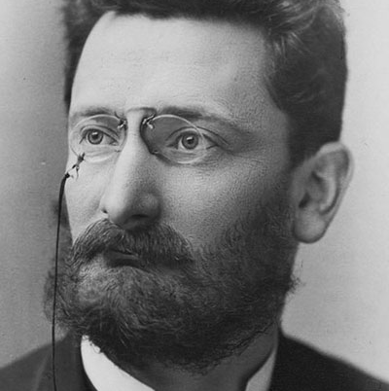
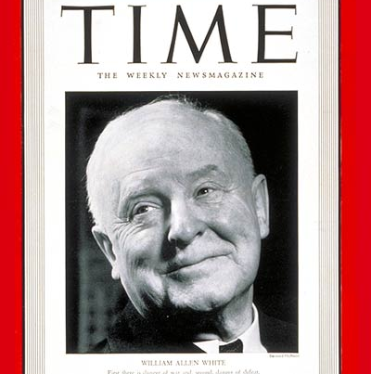
Two men concerned with freedoms
Joseph Pulitzer
William Allen White

Slide 4
Today’s Exercise
Free Speech Exercised
Agree | Disagree
Personal | Patrons

Slide 5
LEGAL AUTHORITY
Freedom of speech includes the right:
Not to speak (specifically, the right not to salute the flag).
West Virginia Board of Education v. Barnette, 319 U.S. 624 (1943).
To use certain offensive words and phrases to convey political messages.
Cohen v. California, 403 U.S. 15 (1971).
To engage in symbolic speech, (e.g., burning the flag in protest).
Texas v. Johnson, 491 U.S. 397 (1989); United States v. Eichman, 496 U.S. 310 (1990).
Freedom of speech does not include the right:
To incite actions that would harm others (e.g., “[S]hout[ing] ‘fire’ in a crowded theater.”).
Schenck v. United States, 249 U.S. 47 (1919).
To make or distribute obscene materials.
Roth v. United States, 354 U.S. 476 (1957).
To burn draft cards as an anti-war protest.
United States v. O’Brien, 391 U.S. 367 (1968).

Slide 6
Does information make us free? Or just frustrated?
Attention economy
Information Overload
USA.gov
https://www.usa.gov/federal-agencies
WorldCat (the World’s Catalog)
www.worldcat.org

Slide 7
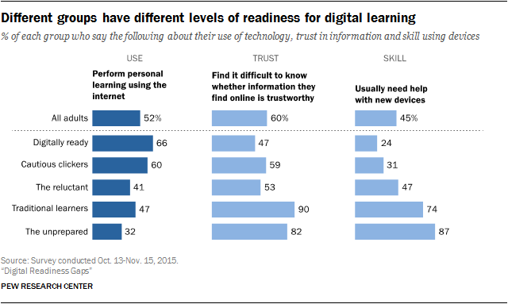
A Pew Facts

Slide 8
What drives free speech today?
“61% of Internet users live in countries where government criticism is restricted. Though widespread globally, censorship is not evenly distributed.”
Emily Barone, Time (2015)
How much to we expose ourselves to other’s opinions?
How do most American’s find information about?:
Government
Medicine
Law
Justice
Each other

Slide 9
What drives free speech in libraries?
Are libraries neutral?
June 2018
American Libraries
Advocacy vs. silence
Politically neutral
Discourse in rural or conservative communities
Do you reflect all of your community?
Who’s left out of the library?

Slide 10
Meeting Rooms
Policies
Policies
Policies
Money
Staff # and time
Reflection of values of diversity

Slide 11
FAKE FAKE FAKE FAKE FAKE FAKE
FAKE FAKE FAKE
FAKE FAKE FAKE

Slide 12
Credible resources vs. Fake News
Factcheck.org
ALA
LIRT
Nicole Cooke

