Slide 1
HR and Libraries
State Library of Kansas and the Kansas Regional Library Systems
Facilitated by: Tiffany L. Hentschel, SPHR, SHRM-SCP
January 24, 2020

Slide 2
Agenda
Welcome
Form I-9
Form W-4, Employee Withholding Certificate
Kansas Withholding Form K-4
Wrap-up and Questions

Slide 3
Form i-9

Slide 4

Who needs to complete Form I-9
All employees hired after November 6, 1986
Employees working for pay or any other type of payment
Special guidance is available for a variety of special circumstances
  Minors who cannot provide proper documentation
  Employees with disabilities
  Asylees and refugees
  Exchange visitors
  Foreign students
  E-Visa holders
This Photo by Unknown Author is licensed under CC BY

Slide 5

Who does not need to complete Form I-9
Employees hired on or before November 6, 1986 who have been continually employed
Domestic workers providing sporadic in-home services
Independent contractors who meet the independent contractor requirements and are not known to be unable to work legally in the United States
Individuals not physically working in the United States
This Photo by Unknown Author is licensed under CC BY-SA

Slide 6
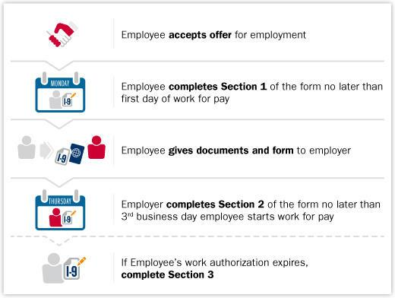
Form I-9 Process

Slide 7
Section One
Include all names, including middle initial if employee has middle name, hyphenated names, multiple first and last names
Maiden or other names
Current address, including street address, city, state, zip and apartment number if applicable
Social security number is NOT required in section one, unless you use E-Verify
Date of birth
Selection of status, including document numbers as appropriate
Signature and date

Slide 8
Section two
Review documents presented by employee: One document from List A OR one document from both List B and C
Complete appropriate portions, including all document and employer information, dates and signatures
Ensure documents are original and reasonably appear to be genuine
MUST be completed within three days of hire

Slide 9

Section three
Must be completed when employment authorization documents expire
May be completed when an employee is rehired within three years or changes their legal name
May not reverify:
  US Citizens
  Noncitizen nationals
  Lawful permanent residents who presented Form I-551
  Permanent Resident or Alien Registration Receipt card for Section 2.
  List B documents
This Photo by Unknown Author is licensed under CC BY-NC

Slide 10

Correcting Form i-9
Draw a line through the incorrect information
Enter the correct information
Initial and date the correction
If significant errors, a new form may be completed and attached, along with a note to file
Do NOT conceal errors or changes
This Photo by Unknown Author is licensed under CC BY

Slide 11

Common errors
All boxes are not completed appropriately
Acceptable documents are not presented
Sections are not completed timely
Signatures are not included
Expired documents are accepted
This Photo by Unknown Author is licensed under CC BY-SA

Slide 12
Calculating Form i-9 Retention
1. Date the employee began work for pay 1. ________________________
A. Add 3 years to the date on line 1. A. ______________________
2. The date employment was terminated 2. _______________________
B. Add 1 year to the date on line 2. B. _____________________
3. Which date is later; A or B? 3. _______________________
C. Enter the later date. C. _____________________

Slide 13
Storing Form I-9
On or off site
Electronic, paper or microfiche
Separate from personnel files so readily accessible for review and audit
Include supporting documentation, as appropriate
Ensure secure and confidential

Slide 14
Form W-4 Employee Withholding Certificate

Slide 15

2020 Form W-4
Required for any one hired in 2020 or making changes to their W-4
Current employees do not need to complete a new form
No longer focused on allowances
Helps ensure multi-income families withhold properly
Changes intended to align specific employee circumstances with the tax withholding tables
Employers may ask current employees to complete a new form, but must advise them it is not required
This Photo by Unknown Author is licensed under CC BY

Slide 16
Step one
Name
Address
Social Security Number
Expected Filing Status
Must be completed by everyone
Note Married but withhold at the higher single rate is no longer an option. Head of Household is included.

Slide 17
step two
Only needs to be completed if applicable
Completed by employees who hold down more than one job a the same time or a married and their spouse also works
Necessary to make sure they have enough withholding. Taxes increase as income rises and looking at income in isolation also results in too little withholding
There are three options employees can choose to make withholding adjustments

Slide 18

Step three
Only needs to completed if applicable
Allows employees to adjust their taxes by claiming credit for dependents
Definitions for the child tax credit and other dependents are included
Employees may consult IRS Publication 972, Child Tax Credits
Employees may include estimates of other tax credits, such as education
Credits will directly offset the amount of withholding
This Photo by Unknown Author is licensed under CC BY-NC-ND

Slide 19
step four
Only needs to completed if applicable
Allows employees to make adjustments to withholding for additional income, deductions and extra withholding
Employees may identify as non-resident alien here
Employees may claim exempt from withholding
Intended to capture non-employment income such as retirement or investments
If self-employment income is included here, only income withholding will be withheld, not Social Security and Medicare taxes

Slide 20
Step five
Required by all
Form is invalid without a signature
If no form or invalid Form is submitted, employer will apply default withholding – single with no other adjustments

Slide 21
Kansas Withholding Form k-4

Slide 22

Kansas Withholding form k-4
Should be completed at hire
Completed again when a change in marital status or number of exemptions
In the absence of valid form, employers should withhold at single rate, no exemptions
This Photo by Unknown Author is licensed under CC BY-SA

Slide 23
Kansas Form k-4
Married employees may claim at the single rate to allow for more appropriate withholding if both employee and spouse are earning Kansas income
Dependents are not counted as allowances more than once
Employees may designate an additional amount to be withheld
Credits that do not apply to Kansas filers have been omitted

Slide 24
What questions do you have?
Thank you for your time, attention and participation today. Please do not hesitate to contact me at any time if there are questions with which I can assist. Take Care, Tif
tiffanyhentschel@gmail.com

Slide 25
Sources cited
https://www.uscis.gov/i-9-central
https://www.irsvideos.gov/Webinars/UnderstandingThe2020FormW4AndHowToUseItToCalculateWithholding
https://www.ksrevenue.org/k4info.html

