Slide 1
Emergency and Disaster Planning for Public Libraries and Their Communities
Jessi Harris, Library Consultant & Information Resources Librarian
Northeast Kansas Library System (NEKLS)

Slide 2

Douglas County Emergency Management
Kate Dinneen, CERT Coordinator/Duty Officer
Joshua L. Taylor, Emergency Management Specialist
https://www.douglascountyks.org/emergency-management

Slide 3
How did this collaboration occur?
Community Emergency Response Team (CERT) training in Lawrence, KS.
https://www.douglascountyks.org/form/cert-course-offerings
Libraries needed to update their plans ASAP!
Library Min-CERT Pilot Program
Additional emergency concerns for libraries
  Print collections, servers, patron privacy

Slide 4
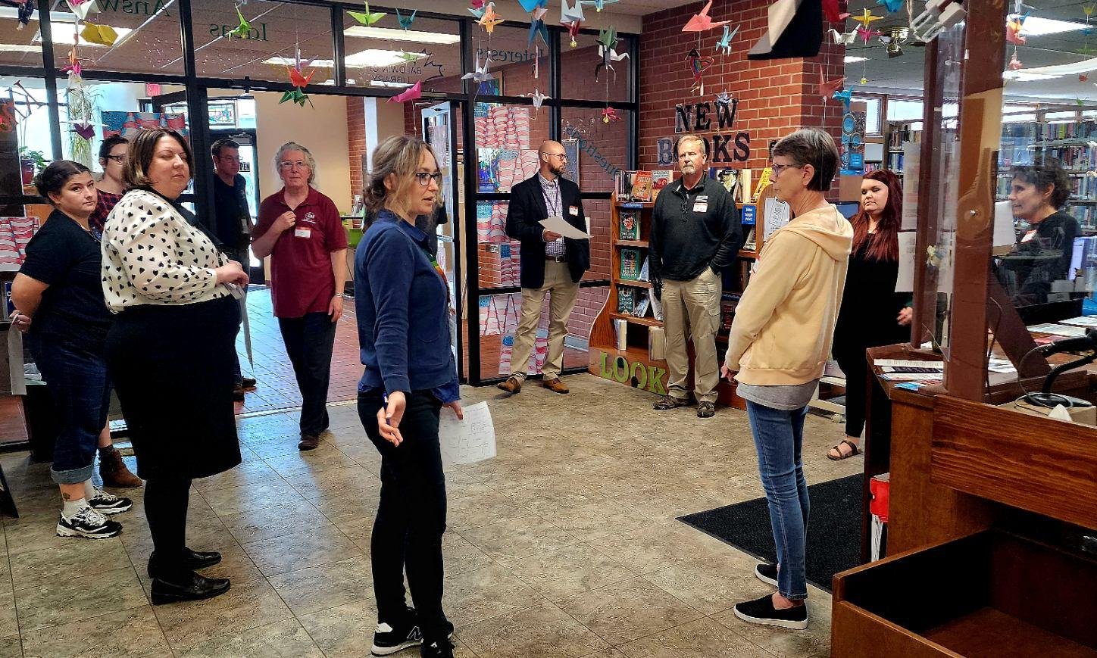
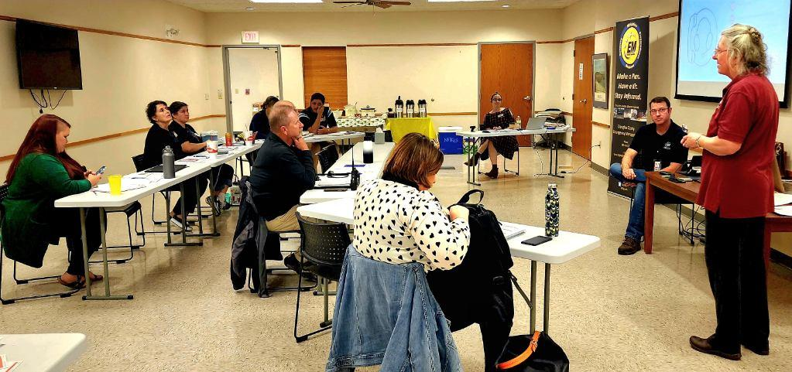
Pilot Program with the Baldwin City Library

Slide 5
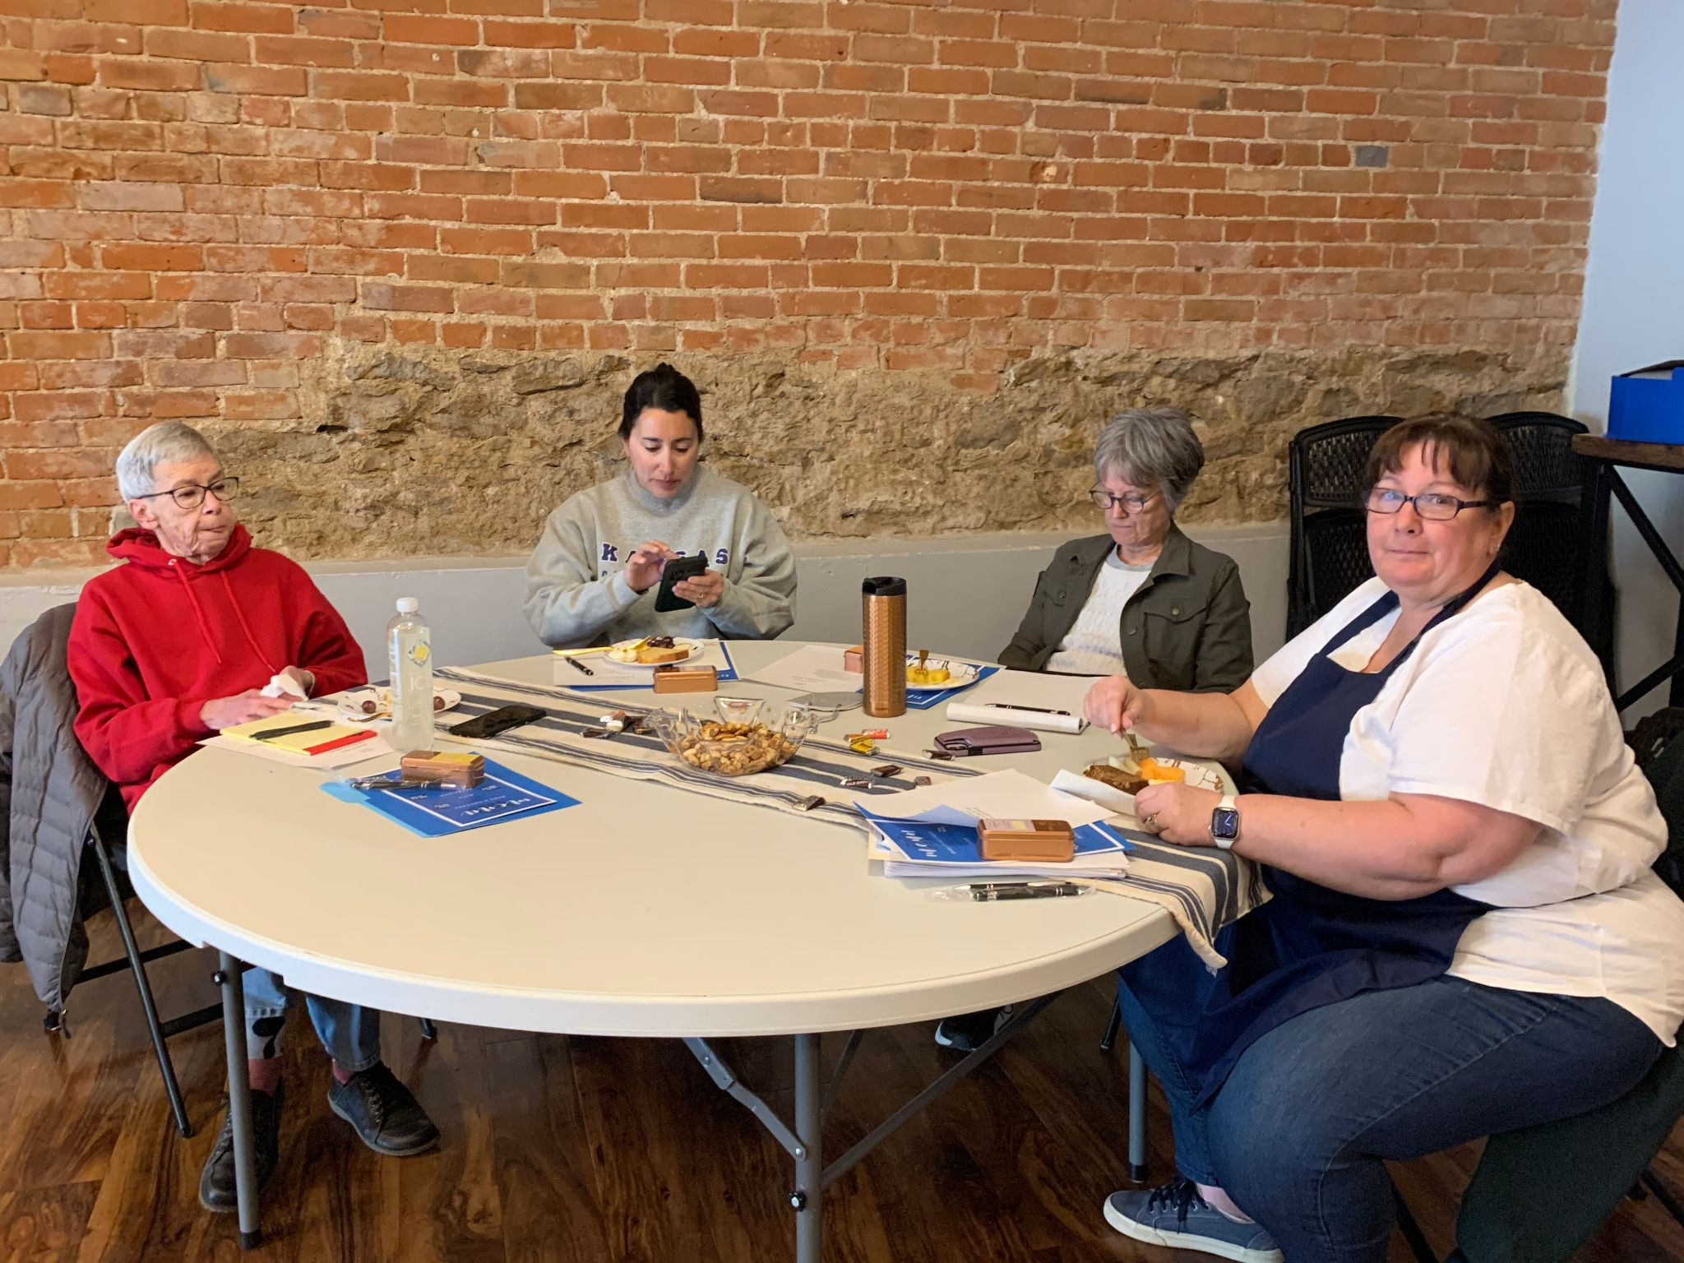
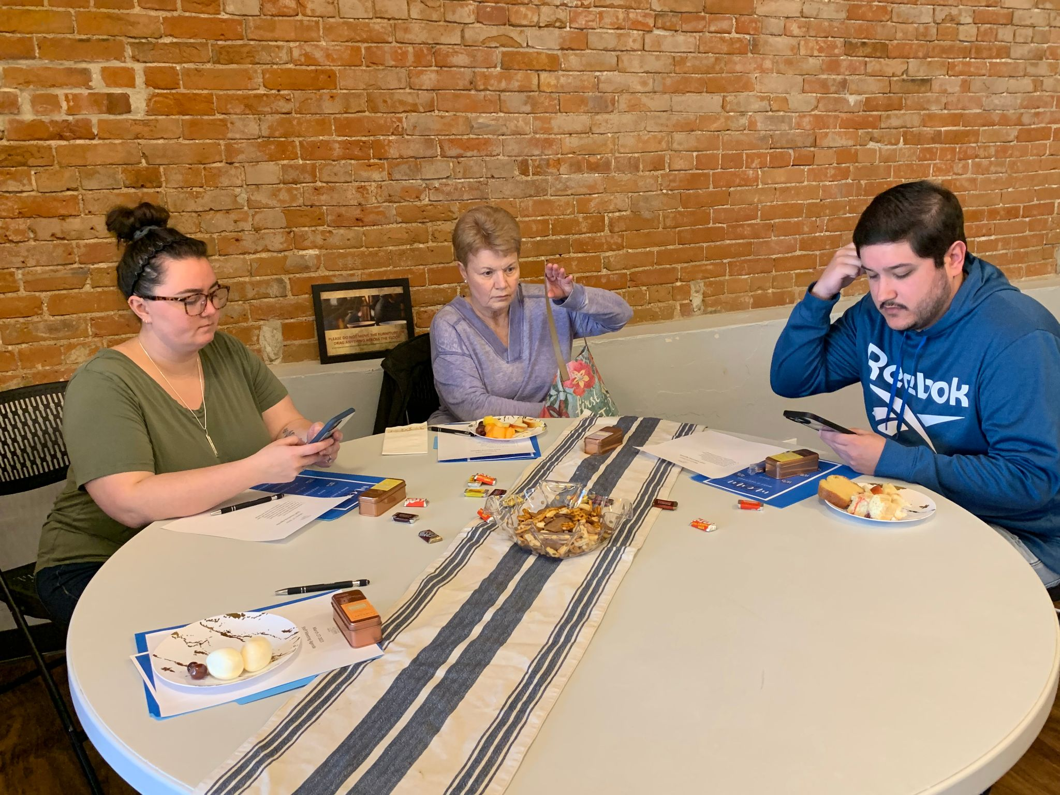
Eudora Community Library & NEKLS

Slide 6
EAP and COOP Templates
Emergency Action Plan
Continuity of Operations Plan
https://systems.mykansaslibrary.org/emergency-action-planning/

Slide 7
Identify
What disasters are more likely to occur in your community/ at your library?
What are your essential functions?
Who are your community partners?
What are your library’s assets?
  Electricity, wifi, charging stations, heating , cooling, bathrooms, water fountains, a place away from the disaster, etc.
What can you provide staff, patrons, and first responders before, during, and after an emergency, or disaster?
Alternate locations, or neighbor libraries for temporary service

Slide 8
Before an Emergency, or Disaster
Develop COOP and Emergency Action Plans
Run Drills with Staff and Patrons
Provide Emergency/Disaster Preparedness Programming (Make it fun!)
Connect and collaborate with your community partners
Know your County Emergency Management Director, or Coordinator
Let your community know what to expect from your library during weather related emergencies.
Test your equipment regularly
  Fire alarms,carbon monoxide alarms, generators, battery backups, Zapp Bug Heaters, etc.
FEMA Mitigation Funding
Notes:
Fire Alarms, generators, battery backups, Zapp Bug Heaters, Flash Lights, etc.

Slide 9
During an Emergency, or Disaster
Are you a designated Tornado Shelter, or Safe Room
  If not, does your community have a shelter? Do they know about it?
  Safe Rooms provide “near absolute protection”
Who on staff will be monitoring the weather (in addition to the weather radio)?
Are you a heating/cooling center? Does this only apply during typical open hours?
Prepare communication with the public for likely events. Share it with the public if there is time and you are in a safe location.

Slide 10
After an Emergency, or Disaster (Recovery)
If you are expected to be the community emergency hub, do you have a generator? If not, do you have plans how to rent/borrow one?
Communication with the public regarding the library’s status and what services are available.
  Computers and devices for patrons to fill out FEMA forms.
Keep track of volunteers to thank them after the recovery.
Keep track of all expenses during the recovery for possible FEMA relief support reimbursement.

Slide 11
Learn From Others’ Experiences
Library collapse due to nearby construction
Carbon Monoxide in the library
Chemical Fire near the library, not able to get to the cars in the parking lot
Left the meeting room contact binder at the library during a blizzard
Know how to use a fire extinguisher in advance
The director breaks their leg
The director dies unexpectedly
Two, or more, emergencies occurring simultaneously

Slide 12

What experience(s) did you learn the hard way?

Slide 13
Resources
Kansas Regional Library System Website
  https://systems.mykansaslibrary.org/emergency-action-planning/
The Disaster Planning Handbook for Libraries by Mary Grace Flaherty
Kansas County Emergency Management Director contacts
  https://www.kansastag.gov/449/County-Emergency-Manager-Contacts
Douglas County Emergency Management
  https://www.douglascountyks.org/emergency-management
Douglas County CERT Training
  https://www.douglascountyks.org/emergency-management/community-emergency-response-team
FEMA Training and Education
  https://www.fema.gov/emergency-managers/national-preparedness/training
Ready Kids
  https://www.ready.gov/kids

Slide 14

Contact Information
Jessi Harris (she/her/hers)
Library Consultant & Information Resources Librarian
Northeast Kansas Library System (NEKLS)
jharris@nekls.org

