Slide 1


Library Programming for Adults Living with Dementia
PRACTICAL PROGRAM POSSIBILITIES
Tami Hurst
Program Specialist, Library to You
Olathe Public Library

Slide 2
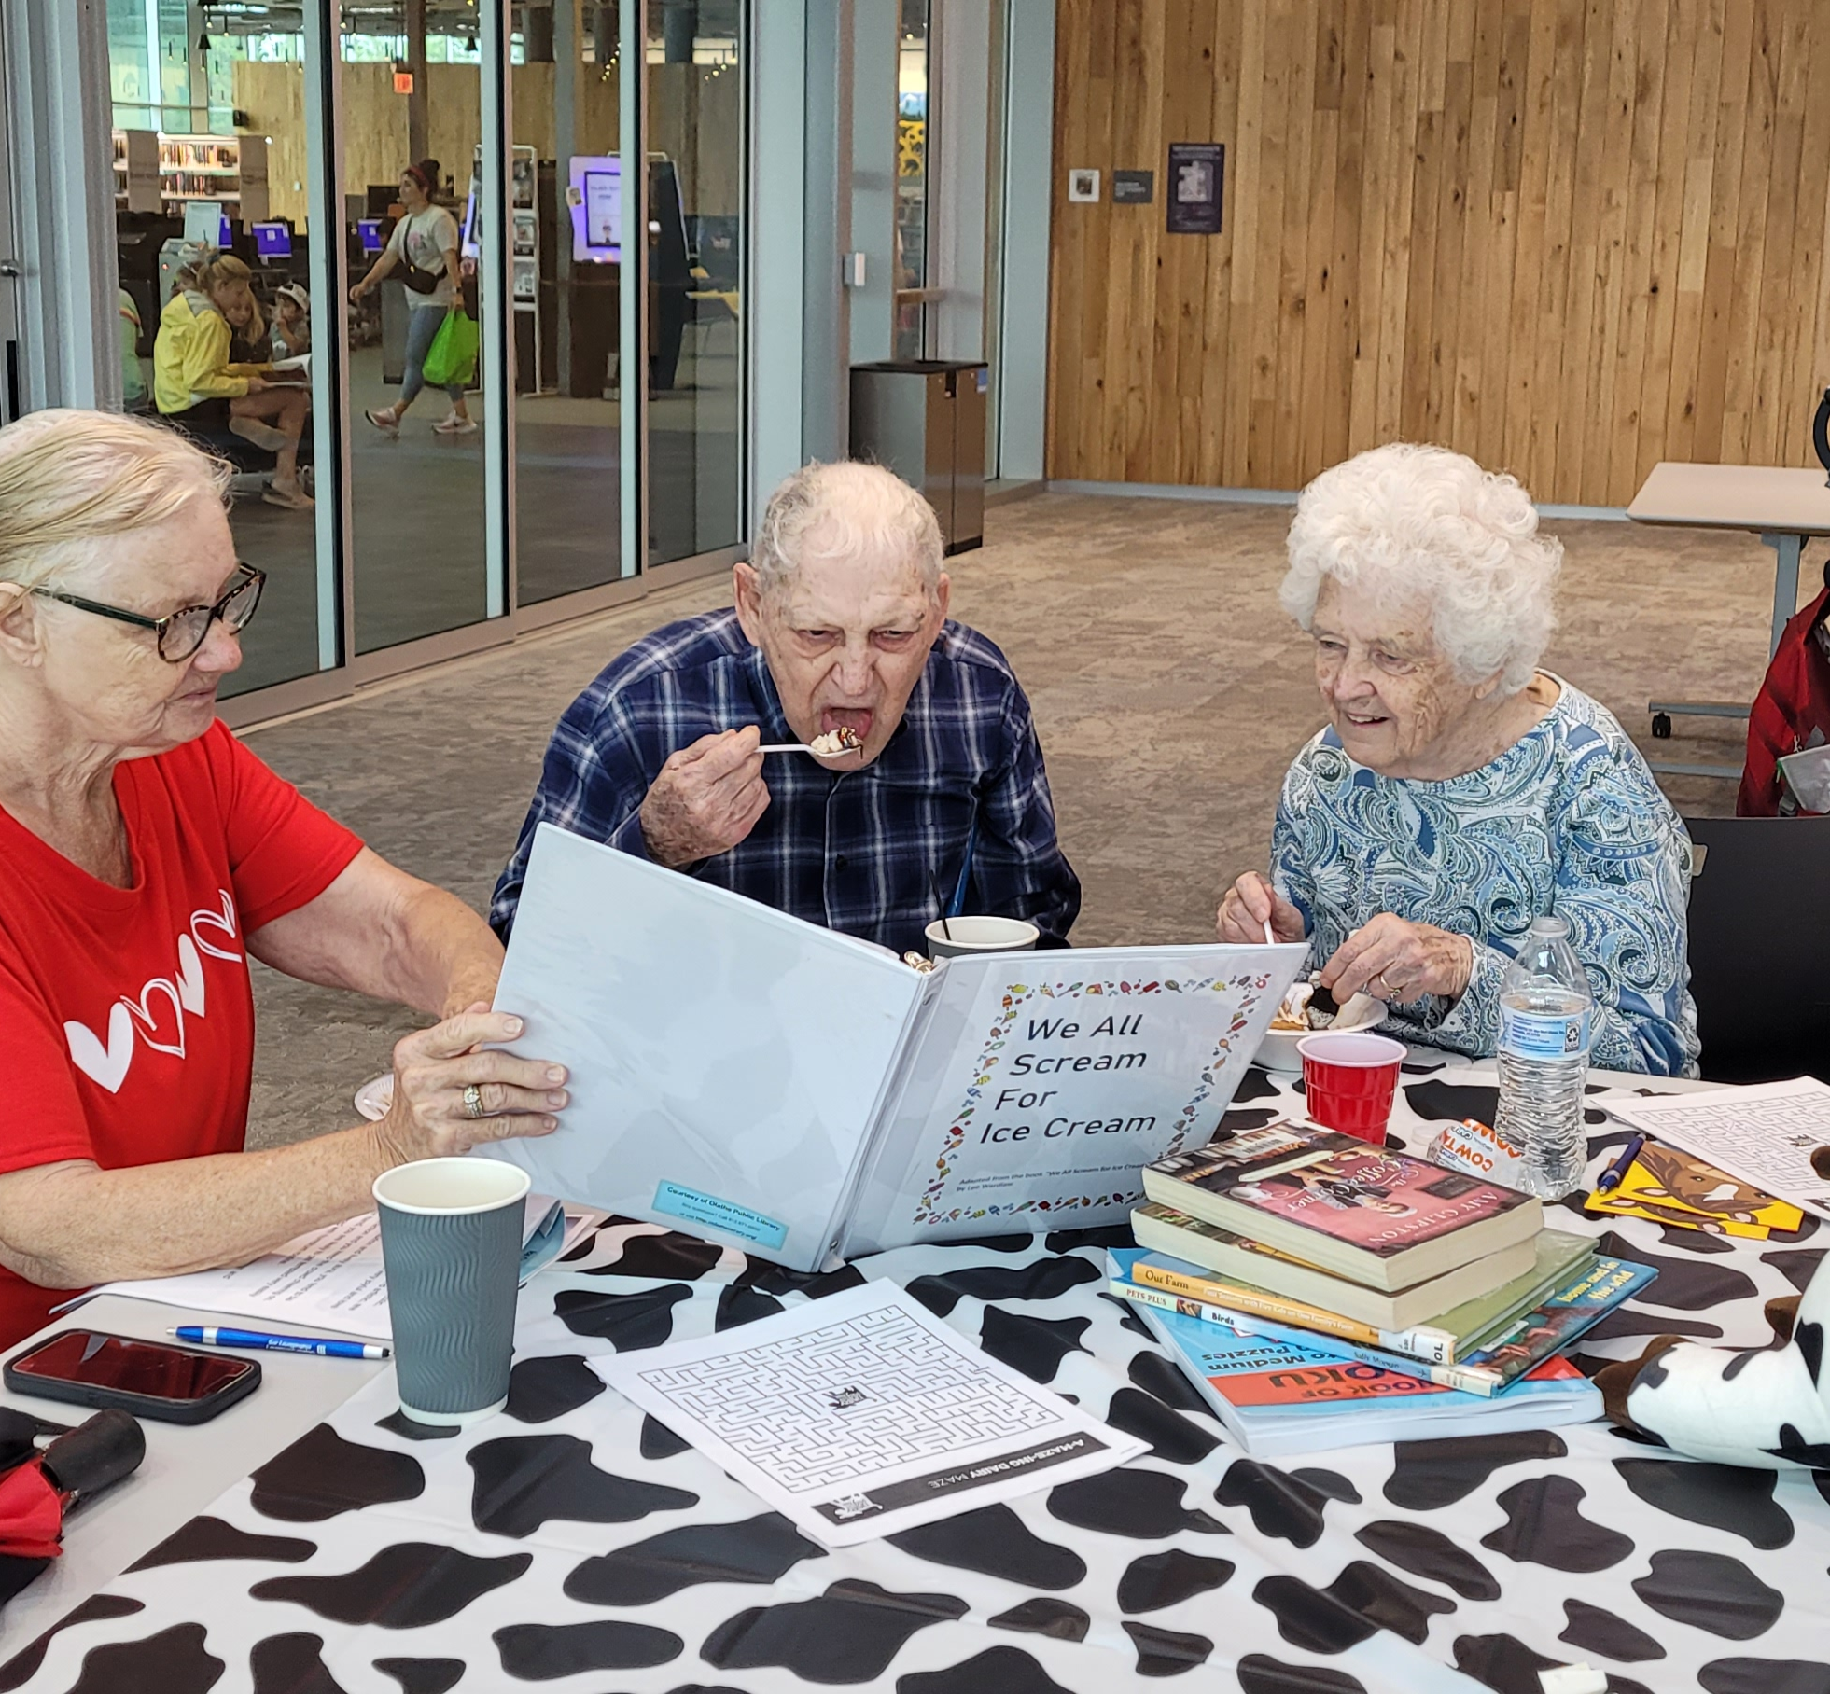
Part I: What does reading look like for someone living with dementia?

Slide 3
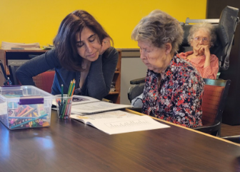
Reading often looks different for someone living with dementia.
The changes that take place in the brain, eyes and other parts of the body as dementia progresses can sometimes make “normal” reading materials inaccessible.
Problems with short term memory, endurance, processing time, eye muscle control, ability to focus, etc. can cause individuals living with dementia to need adaptations in order to be successful reading.

Slide 4
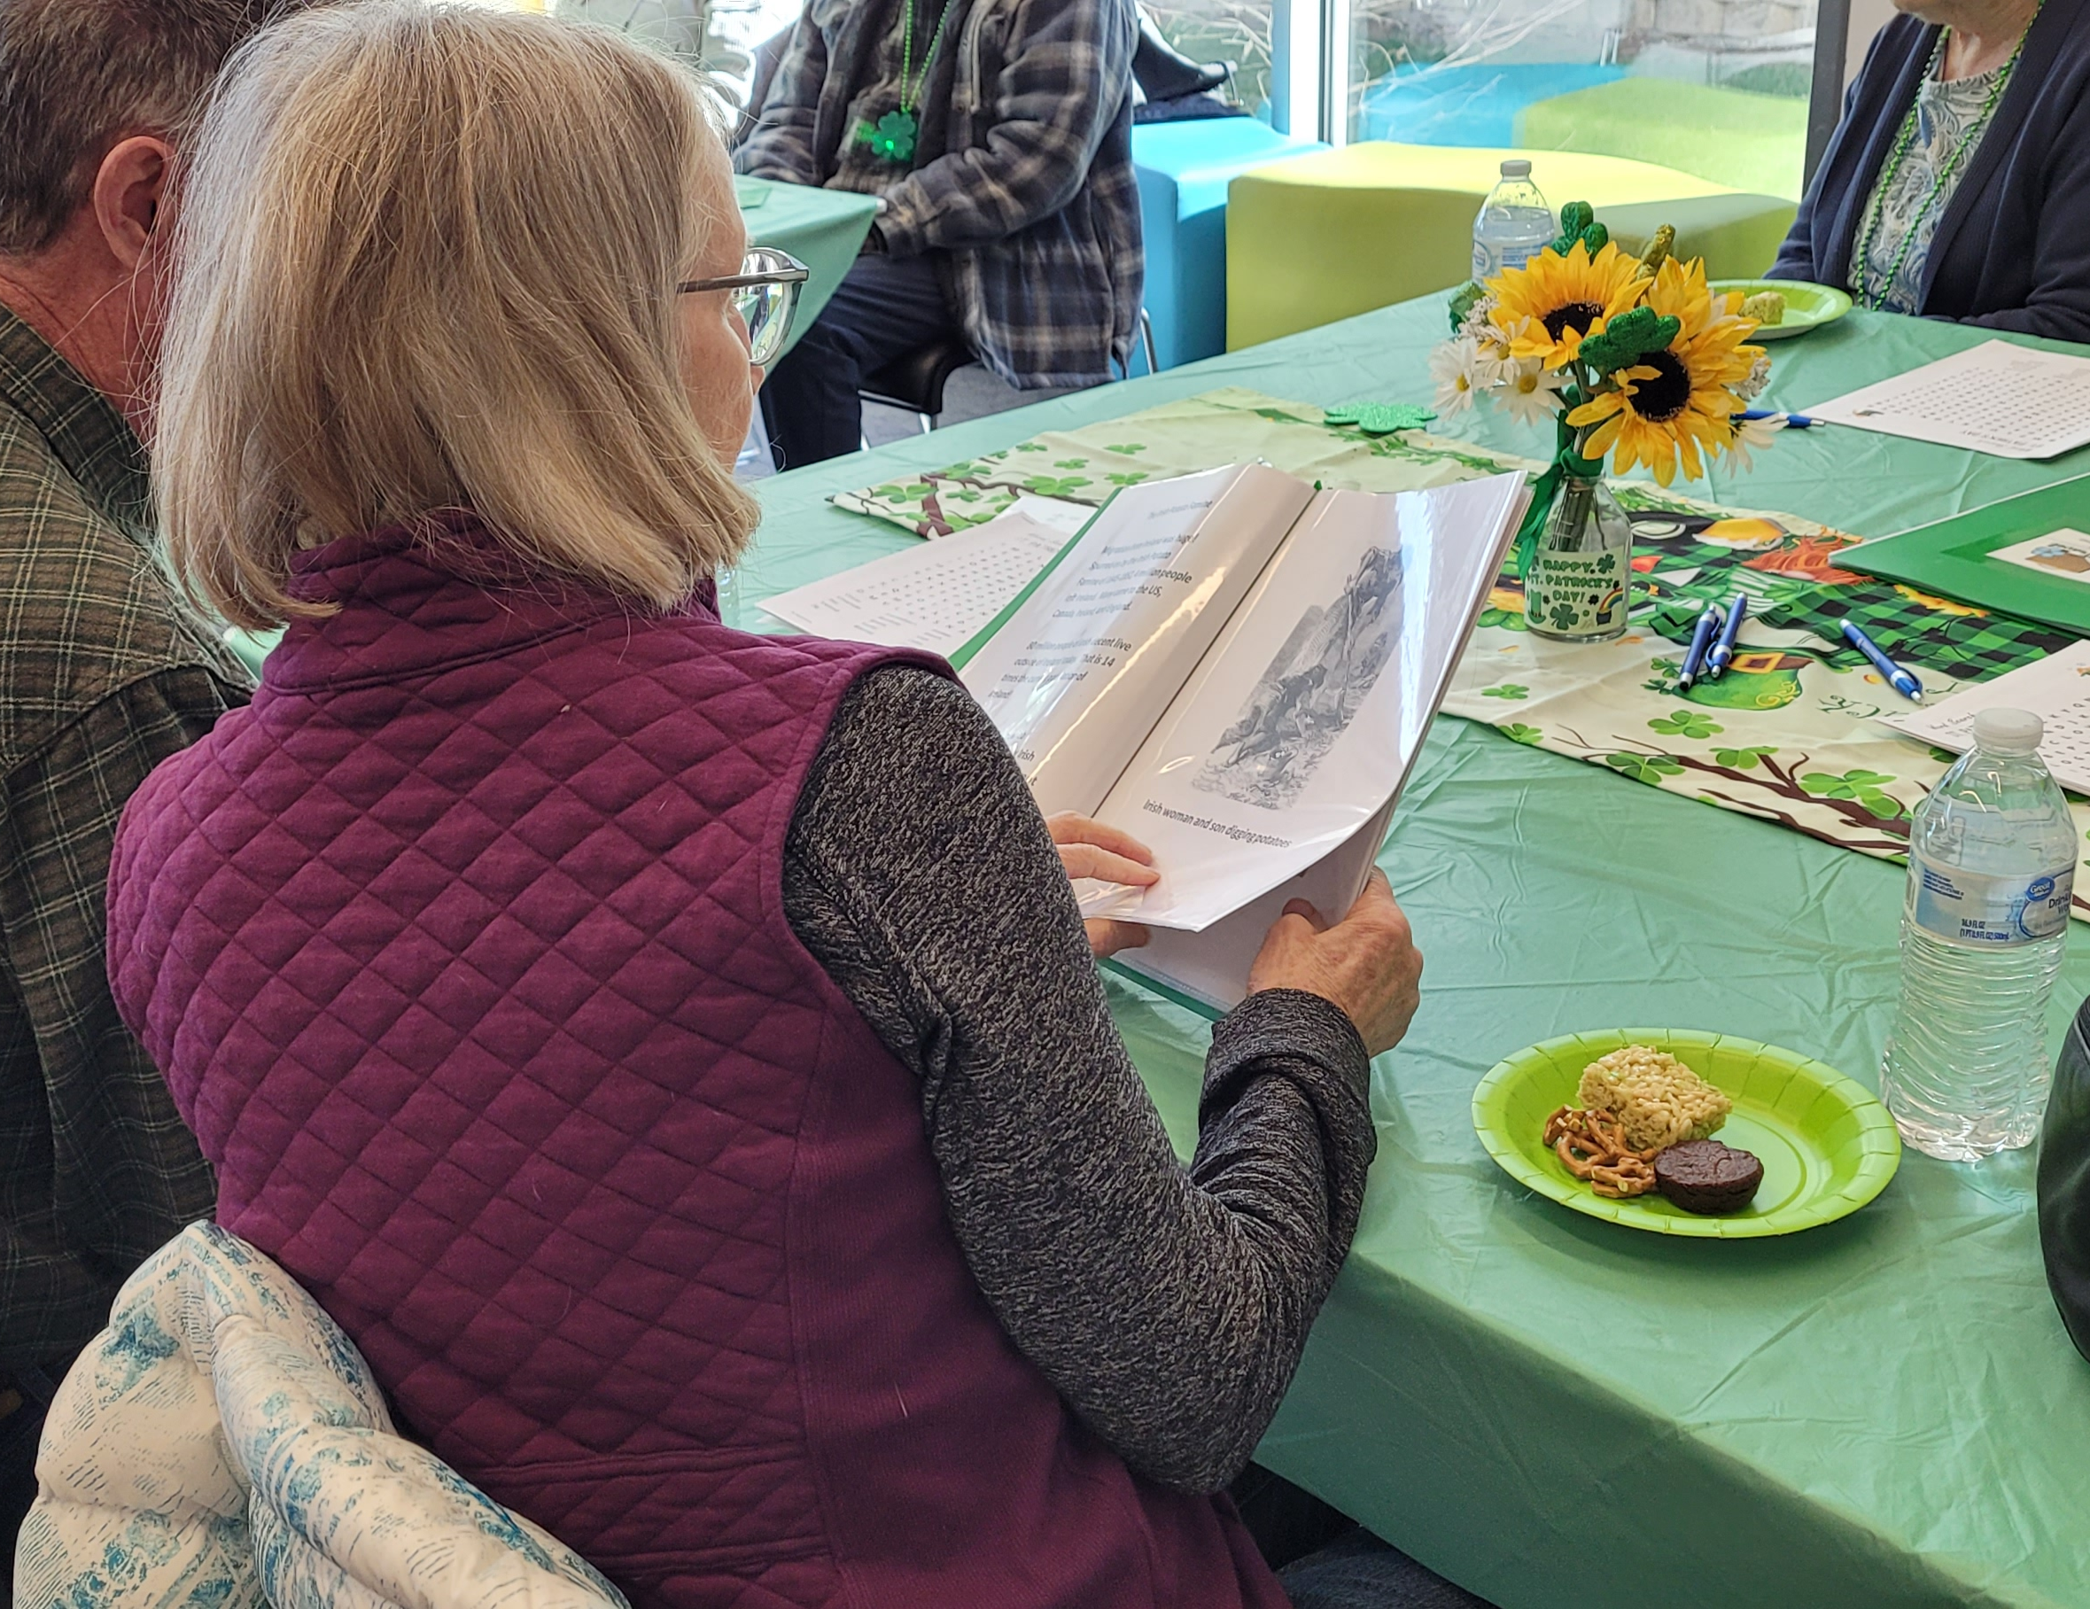
What do accessible materials look like?
Larger font
Bold text if possible
More space between lines
Simpler language
Actual photographs (no cartoons)
Short—less text on the page and less total pages
**ON A TOPIC OF INTEREST**

Slide 5

Children’s
Non-fiction

Slide 6


Slide 7
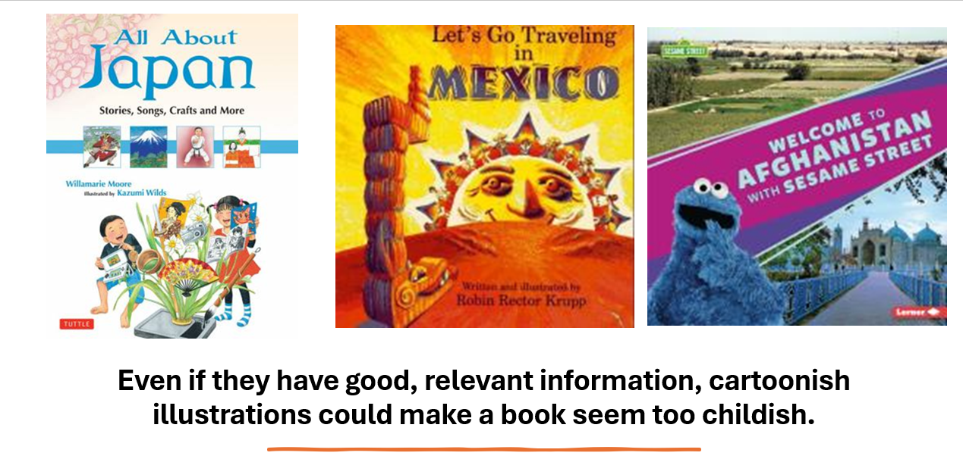

Slide 8
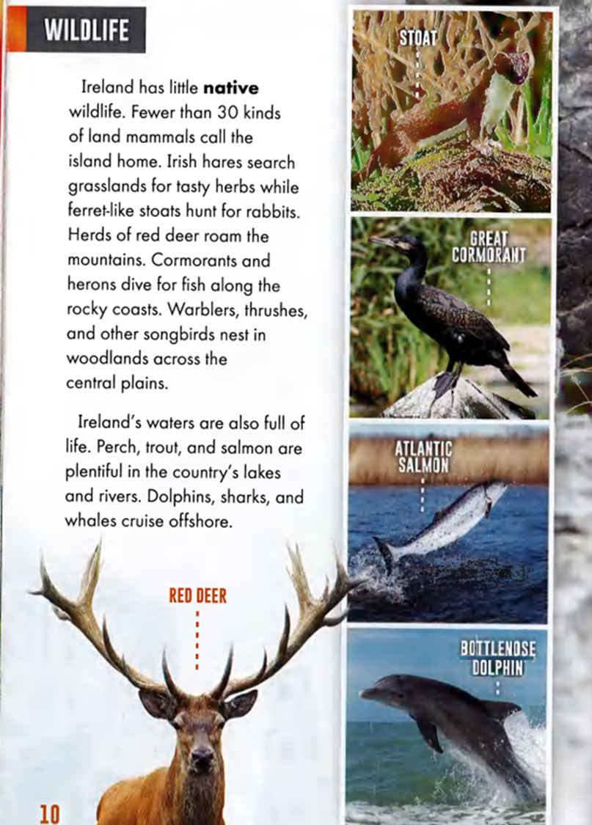
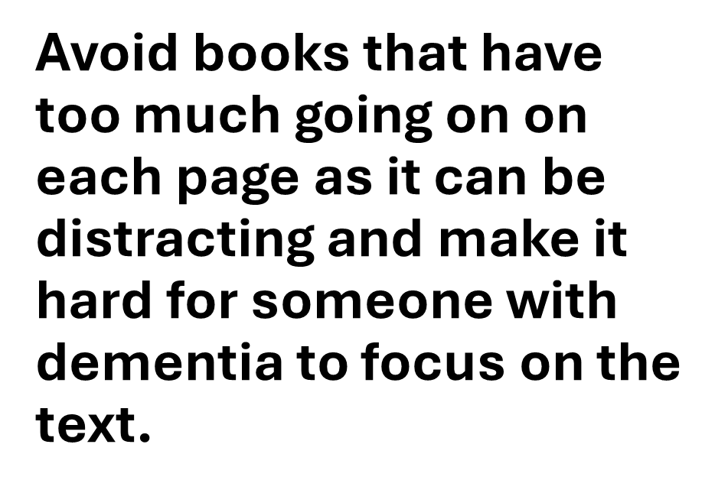

Slide 9

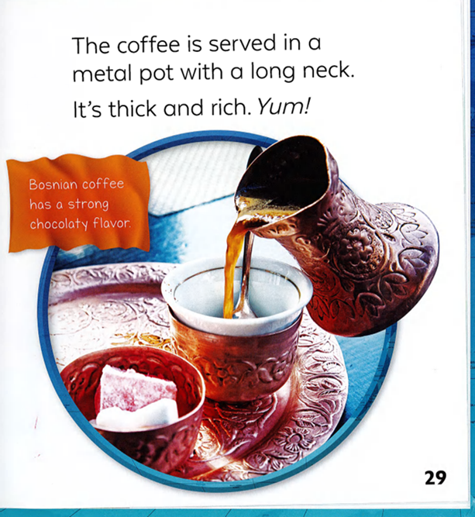
Consider your audience. In some cases, very simple text is good, but it should NOT read like a beginning reader.
Consider the difference between these two examples:

Slide 10


Slide 11
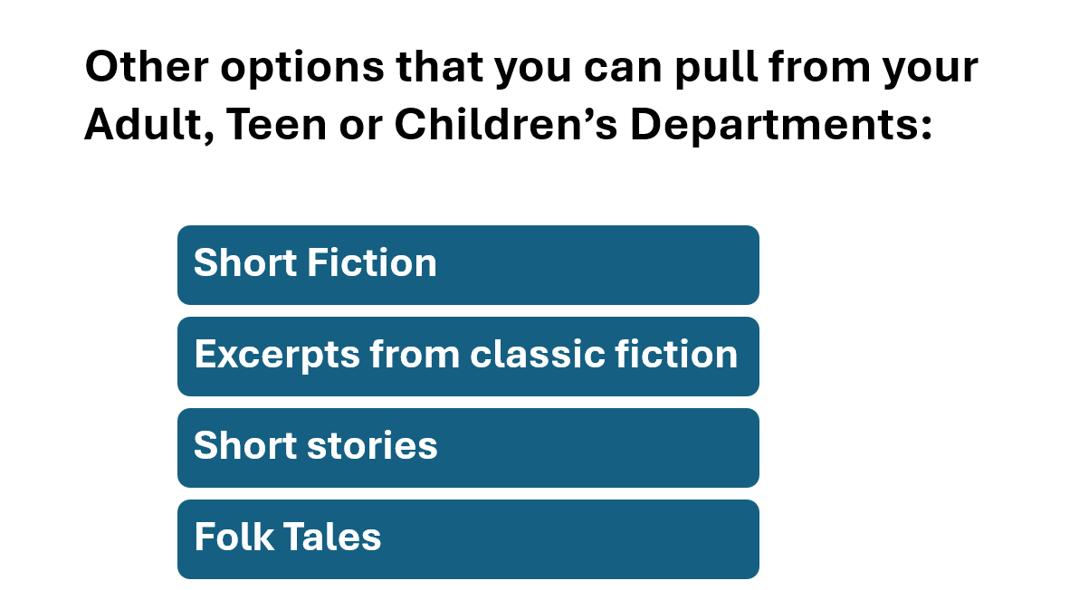

Slide 12
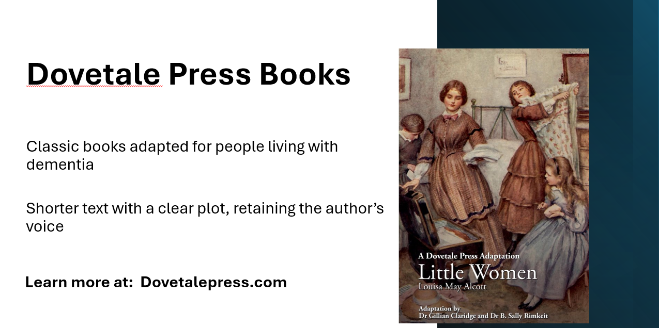

Slide 13
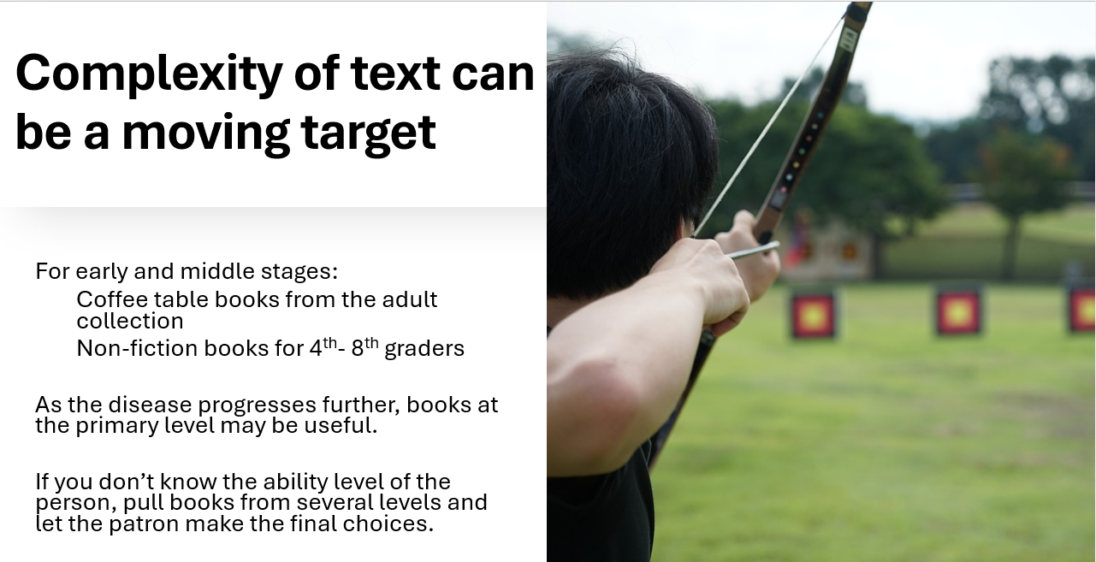

Slide 14

A change of mindset
about reading
Doesn’t have to be books! Any kind of interaction with text and/or pictures counts.
Social interaction is just as important as interaction with text—and it’s still using language.

Slide 15
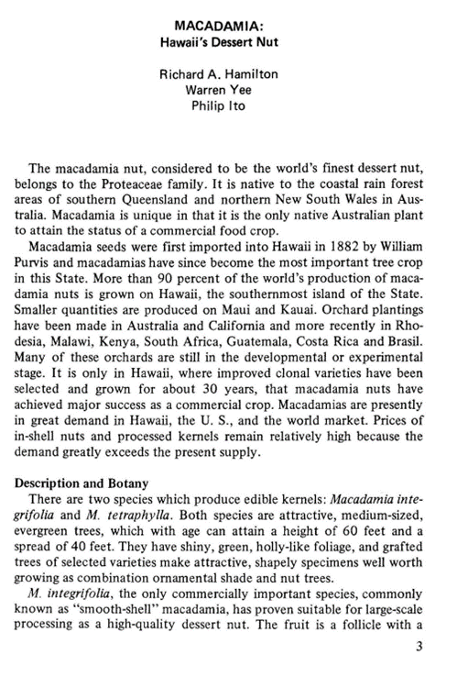
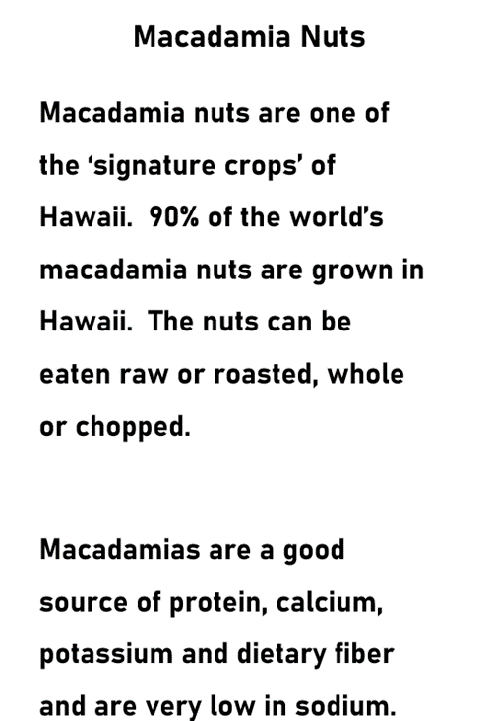


Slide 16
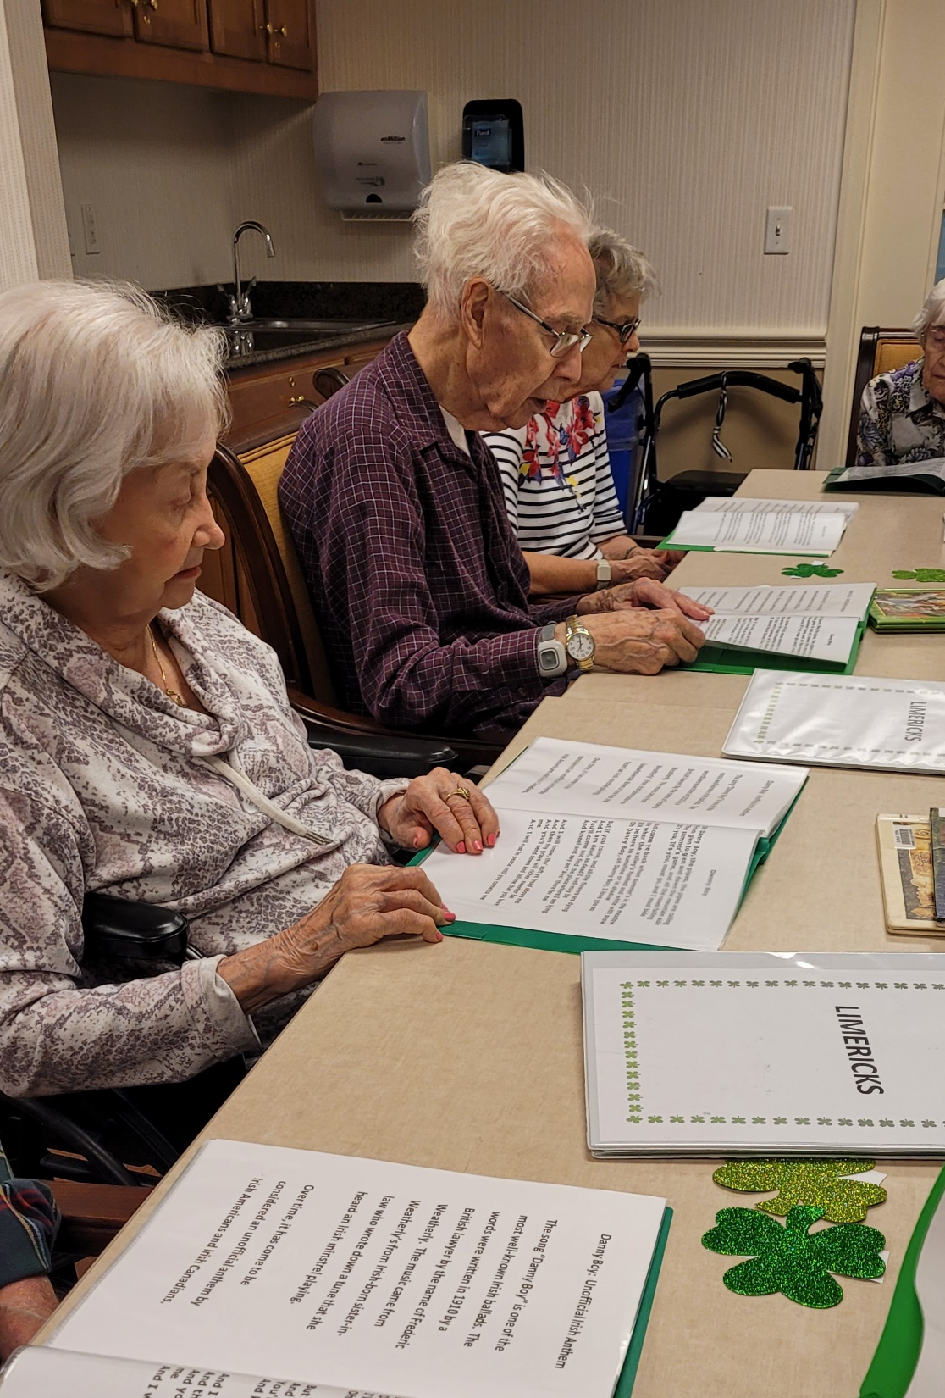
Part II: Programming Ideas that include opportunities for reading

Slide 17

Tales and Travel
Memories
!!FREE!!
www.talesandtravelmemories.com
Specifically designed for folks living
with dementia.
Evidence-based
Adaptable

Slide 18
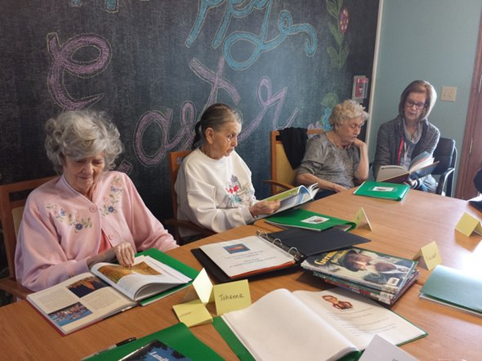
A very important part of the Tales and Travel Memories program is leaving time at the end for participants to thumb through books and discuss the topic.

Slide 19
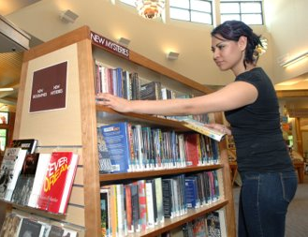
What kinds of books do we bring?
Our booklets double as reading material
Children’s non-fiction books​
​
Coffee table books​
​
Occasionally travel brochures or maps ​

Slide 20

This is where the magic happens…

Slide 21
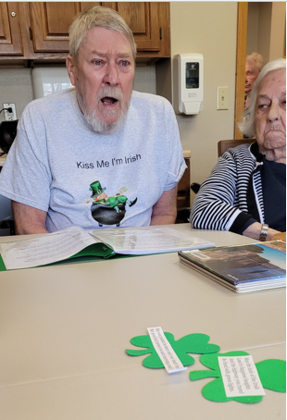
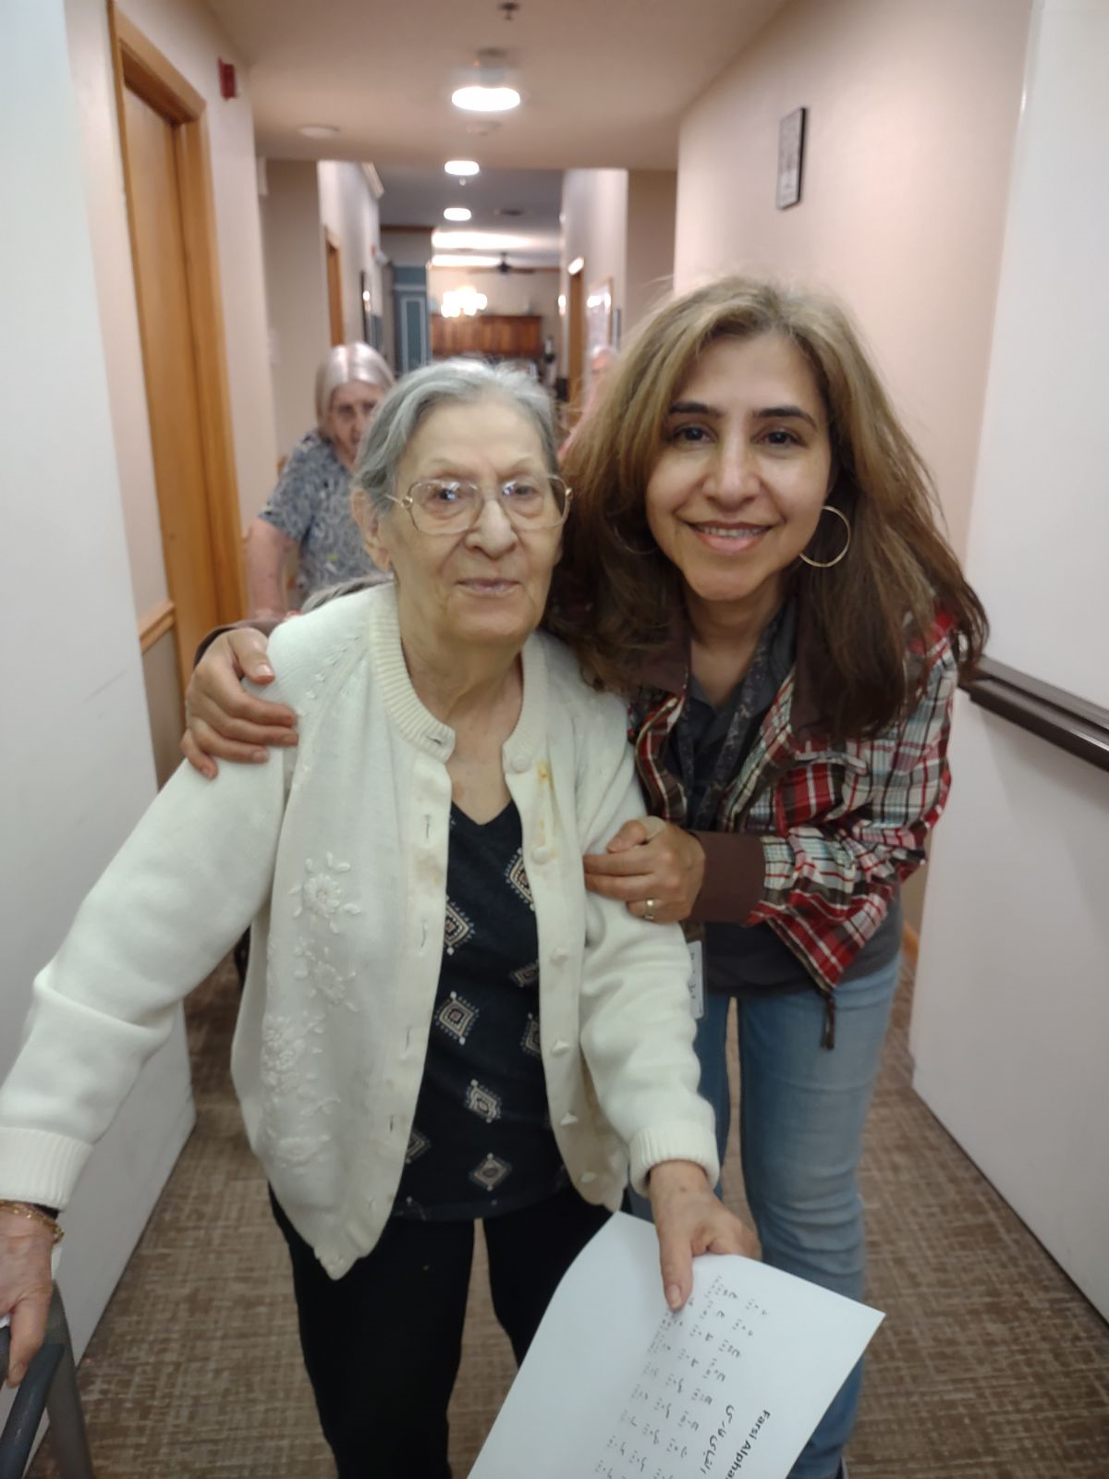

Slide 22

Reading is more than just books…

Slide 23
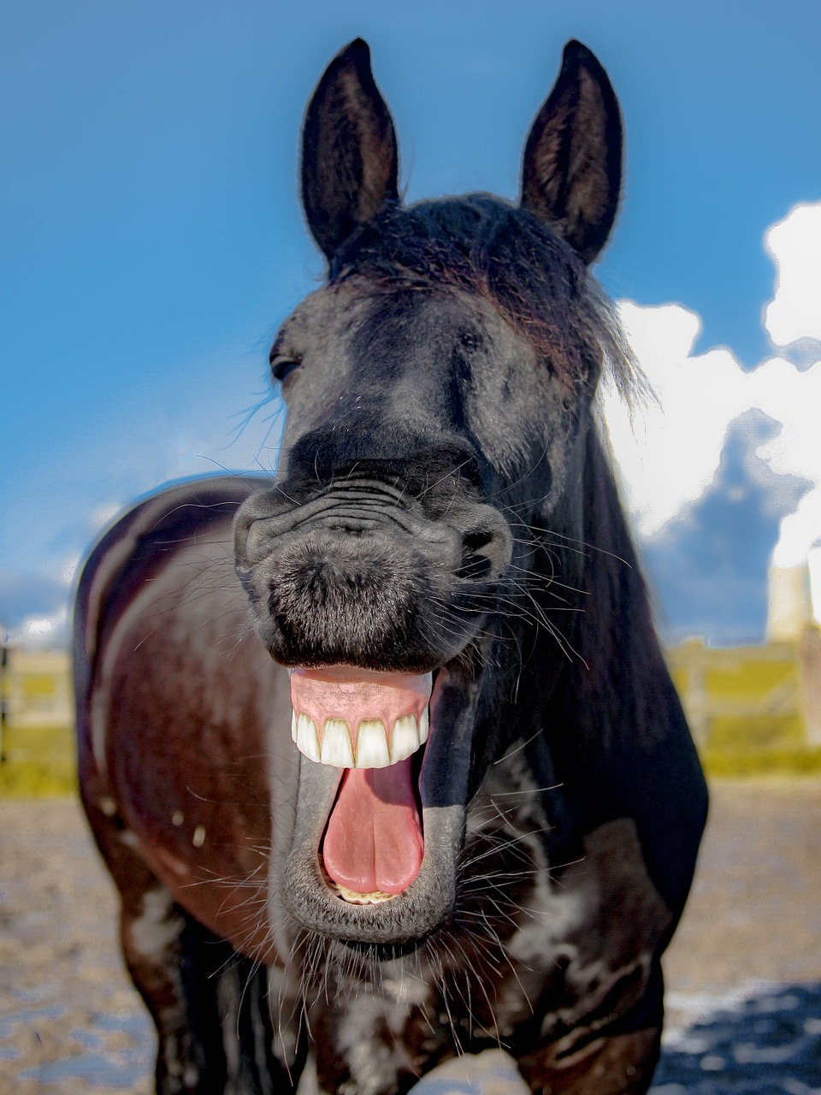

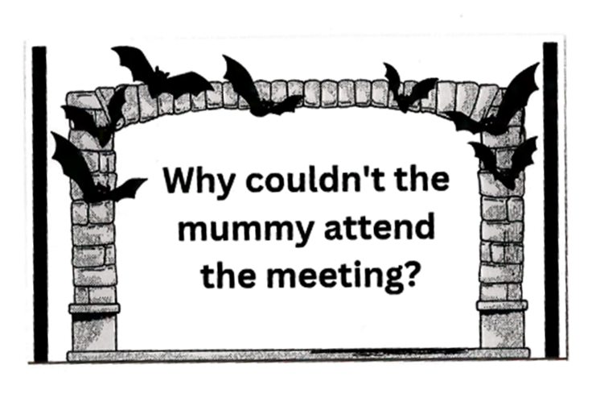
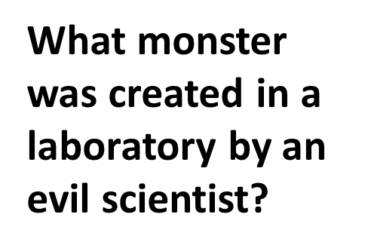
Try trivia or jokes
Type up trivia questions or jokes around a theme of interest. Have the participants take turns answering the questions or reading the jokes.

Slide 24
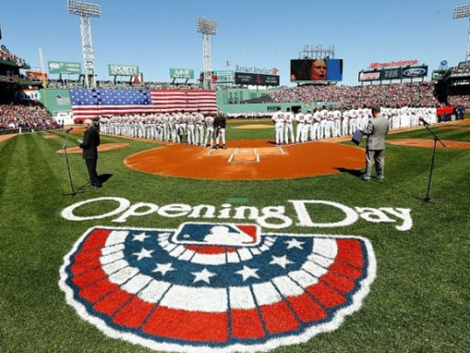
Newspaper or
magazine articles
Example: Stein, Jared. “Why We Love Opening Day.” Gunaxin, 30 March 2018.
https://gunaxin.com/love-opening-day
Excerpt:
“Do we really need another reason to play hooky from our lives and escape to the ballpark for a few hours? I think not. Heading out to catch your team kick off the season with your friends and like-minded fans while enjoying some of America’s finest over-priced beer is the preamble to Memorial Day. Opening Day for Major League Baseball symbolizes the change of seasons from our dark, cold winters to our chirpy, sunny start of spring. Like Memorial Day, it is not officially the start of the new seasonal change, but it is, for all intents and purposes the start of the new season, and for that, we celebrate.”

Slide 25
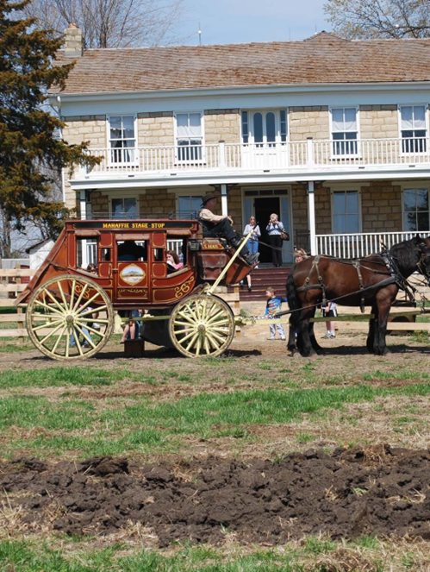
Local History
Is there a local history site in your area? A famous landmark? A factory that produces something unique?
Chances are good that there is already appropriate literature written that talks about the place. Check on their website or with their visitor’s center.
You may need to enlarge the text for your readers.
Your readers may already know the place, which could spark good discussions.

Slide 26


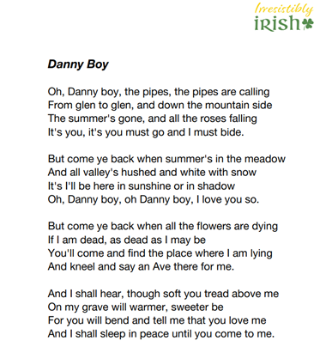
Use Music Lyrics as Reading Material
Read printed lyrics to songs as poetry, use them for a singalong or sing along with a video with captioned lyrics.

Slide 27
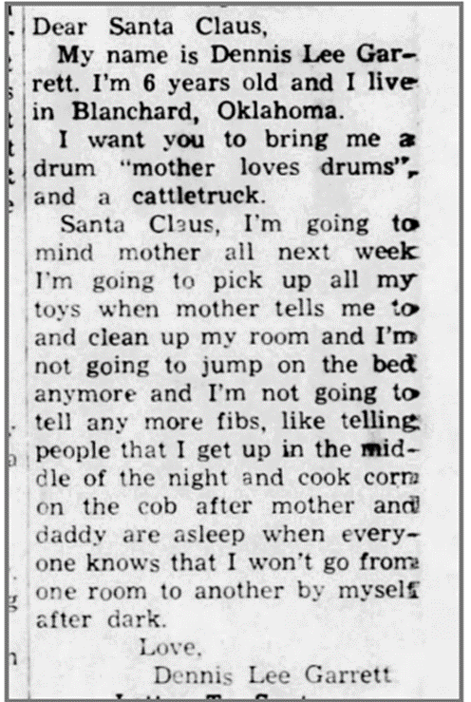
Seasonal Reading Activities
Read letters to Santa that children have written that were published in the newspaper.
You can find these on the internet or by searching through old newspapers online such as newspapers.com or Chronicling America. Enlarge the text on a copy machine for easier readability.
These are funny, but they also evoke childhood memories of favorite toys and holiday traditions. This can lead to lively discussions.
The Blanchard News (Blanchard, Oklahoma) · 22 Dec 1960, Thu · Page 7

Slide 28
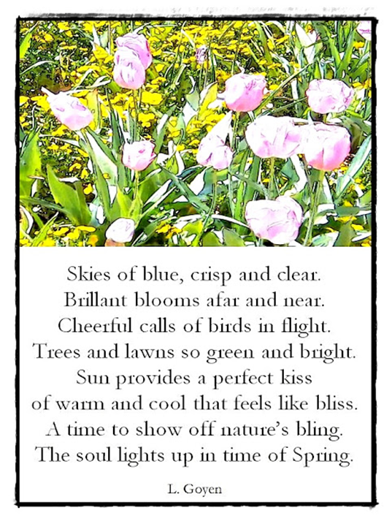
Don’t forget Poetry
Choose several poems on a similar topic like “Spring” and take turns reading and discussing.
Use short poems (maximum one page)
Participants can take turns reading, or
a call and response technique can be used.
Check out Gary Glazner and
the Alzheimer’s Poetry Project: www.alzpoetry.com or on YouTube

Slide 29
Some resources to get you started:
LSDA (Library Services for Patrons with Alzheimer’s/Dementia
Special interest group through ALA’s Office of Equity, Diversity and Inclusion
You do NOT have to be a member of ALA to access their website with resources or their list serve.
https://www.ala.org/advocacy/diversity/services-alzheimers
Books:
McNichol, Sarah (2023). Supporting People to Live Well with Dementia: A Guide for Library Services, Facet Publishing, 2023, ISBN 978-1783305971
Dickey, Timothy (2020). Library Dementia Services: How to Meet the Needs of the Alzheimer's Community, Emerald Publishing Limited, 2020, ISBN 978-1838676940

Slide 30
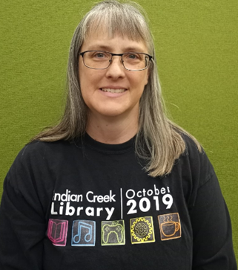
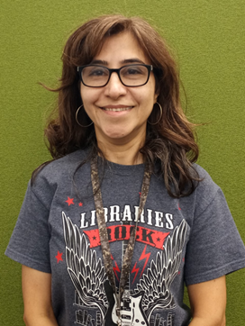
Questions??? We’d love to hear from you!
Tami Hurst Roya Mortazavi
Programming Specialist Programming Specialist
Outreach and Library to You Outreach and Library to You
Olathe Public Library Olathe Public Library
thurst@olatheks.org Rmortazavi@olatheks.org
913-971-6843 913-971-6843

